Slide 1
Overview of Using Data: Definitions
EBA Chapter 2.1

Slide 2
Basic Terminology
Company | Industry | Sales ($ Millions) | CEO Pay ($000) | ROE (%)
Boeing | High Tech | 56154.0 | 999 | 9.1
Delta Airlines | Transportation | 14402.0 | 1776 | 26.4
Best Buy | Consumer Products | 9471.7 | 1587 | 19.3
Chase Manhattan | Financial Services | 32379.0 | 6229 | 16.2
Variables
Elements
Data set
An observation
Source: Executive Compensation Scoreboard, Business Week, April 19, 1999

Slide 3
Basic Terminology
Data: The facts and figures collected, analyzed, and summarized for presentation and interpretation
Element: The entities on which data are collected
Variable: A characteristic or a quantity of interest that can take on different values
Observation: Set of values corresponding to a set of variables

Slide 4
Types of Data
Different types of data should be analyzed differently
EBA Chapter 2.2

Slide 5
Terminology
Population: All elements of interest
Examples:
All stocks traded in a stock market
Everyone enrolled in the Alberta Health Care Insurance Plan
Sample: Subset of the population
Examples: The Dow Jones Index, medical trial
Random sampling - A sampling method to gather a representative sample of the population data

Slide 6
Types of Data
Quantitative data: Data on which numeric and arithmetic operations, such as addition, subtraction, multiplication, and division, can be performed
Categorical data: Data on which arithmetic operations cannot be performed
Company | Industry | Sales ($ Millions) | CEO Pay ($000) | ROE (%)
Boeing | High Tech | 56154.0 | 999 | 9.1
Delta Airlines | Transportation | 14402.0 | 1776 | 26.4
Best Buy | Consumer Products | 9471.7 | 1587 | 19.3
Chase Manhattan | Financial Services | 32379.0 | 6229 | 16.2

Slide 7
Types of Data
 | Gender | Final Degree | Body Temperature | Age
John Doe | Male | Bachelor | 36.5 | 25
Jane Doe | Female | Masters | 37.0 | 29
Categorical
(Qualitative)
- data on which numeric and arithmetic operations cannot be performed
Quantitative
- data on which numeric and arithmetic operations can be performed

Slide 8
Scale of Data
 | Gender | Final Degree | Body Temperature | Age
John Doe | Male | Bachelor | 36.5 | 25
Jane Doe | Female | Masters | 37.0 | 29
Nominal Scale
- Labels or names used to identify an attribute of the element
Ordinal Scale
- Have the properties of nominal data, but the order or rank of the data is meaningful
Interval Scale
- Have the properties of ordinal data, and the distance between values are interpretable
Ratio Scale
- Have the properties of interval data, and the ratio of two values is meaningful

Slide 9
Scale of Data
The scale determines the amount of information contained in the data
The scale indicates the data summarization and statistical analyses that are most appropriate
Scale of Measurements

Slide 10
Scale of Measurements
The data consist of labels or names used to identify an attribute of the element
Objects are classified into categories or some assigned numbers with no quantitative difference between them
Some examples of variables that use nominal scale include color (red, green, blue, etc.), a country’s international telephone access code (1, 65, 86, and so on), etc.
Data collected using nominal scale are called nominal data
Nominal Scale
The data exhibit the properties of nominal data and in addition, the order or rank of the data is meaningful
The distances between ranks are not interpretable
For examples, we can code educational achievement as 1 = less than college degree, 2 = college degree, and 3 = post college. However, the distance from 1 to 2 is not the same as the distance from 2 to 3, and in fact, these distances are not interpretable
Ordinal data can also be recorded by a numerical code
Data collected using ordinal scale are called ordinal data
Ordinal Scale

Slide 11
Scale of Measurements
The data have all the properties of ordinal data and the distance between values are interpretable (i.e., have meanings)
However, interval scale does not include a true zero point, so it is not possible to make statements about how many times higher/lower one observation is than another
An examples of interval scale is temperature. A 0°C does not imply the absence of the temperature. A difference between 10°C and 20°C is the same as that between 20°C and 30°C. However, a temperature of 40°C is not twice as warm as 20°C
Data collected using interval scale are called interval data
Interval Scale
The data have all the properties of interval data and the ratio of two values is meaningful
It includes a true zero point
It is possible to make statements about how many times higher/lower one observation is than other (allow us to construct meaningful fractions)
An examples is the number of customers served by a restaurant. Twenty customers served represent twice as many as ten customers served
Data collected using ratio scale are called ratio data
Ratio Scale

Slide 12
Timespan of Data
Cross-sectional data: Data collected from several entities at the same, or approximately the same, point in time
Time series data: Data collected over several time periods
Graphs of time series data are frequently found in business and economic publications
Help analysts understand what happened in the past, identify trends over time, and project future levels for the time series
Notes:
Cross-sectional data: The data in Table 2.1 are cross-sectional because they describe the 30 companies that comprise the Dow at the same point in time (April 2013).

Slide 13
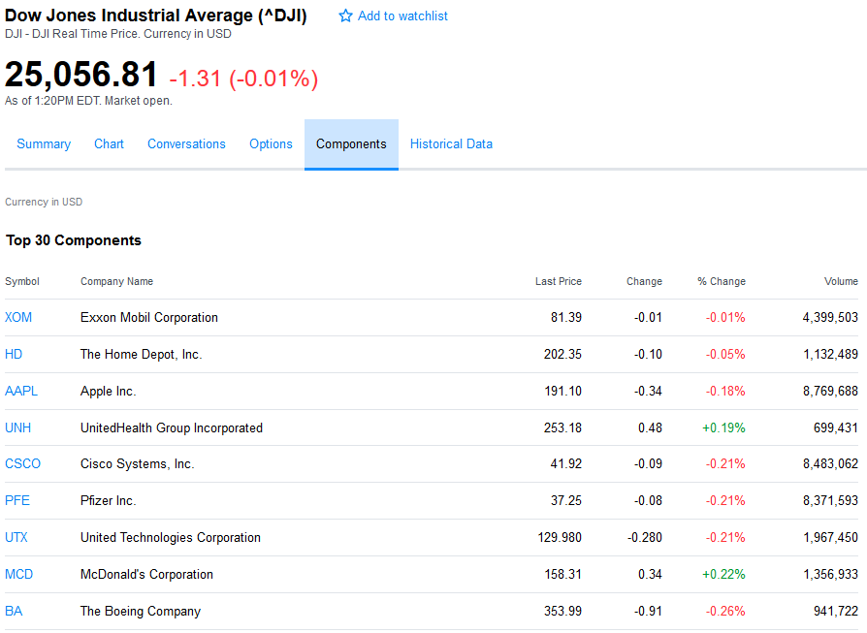

Slide 14
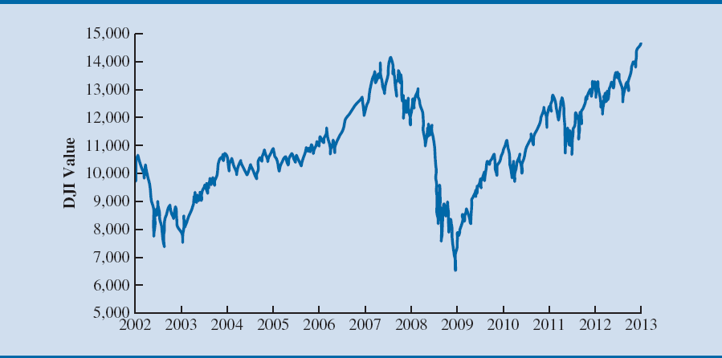
Dow Jones Index Values Since 2002

Slide 15
Data
Scale
Time span
Qualitative data (Categorical data)
Quantitative data
Cross-sectional data
Data collected at the same or approximately the same point in time
E.g. A list of grades obtained by a class of students on a specific test
Time-series data
Data collected over several time periods (usually discrete and equally spaced time intervals)
E.g. Number of students registered for a particular course on a yearly basis
Numerical
Non-numerical
Numerical
Nominal data
Ordinal data
Nominal data
Ordinal data
Interval data
Ratio data
Discrete
Continuous
Discrete, if measuring how many; takes only limited number of values
Continuous, if measuring how much; takes unlimited number of values within a feasible range

Slide 16
Sources of Data
Experimental study - A variable of interest is first identified
Then one or more other variables are identified and controlled or manipulated so that data can be obtained about how they influence the variable of interest
Example: A pharmaceutical firm testing a new vaccine
Nonexperimental (or observational) study - Makes no attempt to control the variables of interest
Example: Analyzing claims data
A survey is one of the most common types of observational study
Notes:
Example:

Slide 17

Customer Opinion Questionnaire
The cost and effort to collect and clean data can be huge
- Data scientists spend 60% of their time on cleaning and organizing data (Forbes)

Slide 18
OM 420/620 Predictive Business Analytics Lecture 2 Relational Database (EBA Appendix B)

Slide 19
Learning Objectives
Relational database
Table in Microsoft Access
Data type
Associations Among Tables
Primary keys
Foreign keys
Entity Relationship Diagram
Example: Stinsons.accdb

Slide 20
Basics of Database
A database is a structured collection of records
Database Management System (DBMS)
add, remove, update records
retrieve data that match certain criteria
cross-reference data in different tables
perform complex aggregate calculation
A table in a database consists of columns (attributes) and rows (records)
Databases versus spreadsheets?

Slide 21
Single Table Database
Orders
CustomerID | CompanyName | City | OrderDate | Product
ALFKI | Alfreds Futterkiste | Berlin | 8/25/1997 | Candy
ANATR | Ana Trujillo Emparedados y helados | México D.F. | 8/8/1997 | Chocolate
ANATR | Ana Trujillo Emparedados y helados | México D.F. | 8/8/1997 | Chocolate
ANTON | Antonio Moreno Taquería | México D.F. | 9/22/1997 | Syrup
ANTON | Antonio Moreno Taquería | México D.F. | 9/25/1997 | Chocolate

Slide 22
Disadvantages of a single table database
Harder to update
Problem with complex data and queries
Security
Potential duplication
Problems in adding incomplete data
Solution:
Relational Database Management System (RDBMS)
E.g. Microsoft Access

Slide 23
The Idea
Create multiple tables instead of one
Records in different tables are linked
Orders
OrderID | CustomerID | OrderDate
10643 | ALFKI | 8/25/1997
10625 | ANATR | 8/8/1997
10626 | ANATR | 8/8/1997
10677 | ANTON | 9/22/1997
10682 | ANTON | 9/25/1997
Customers
CustomerID | CompanyName | City
ALFKI | Alfreds Futterkiste | Berlin
ANATR | Ana Trujillo Emparedados y helados | México D.F.
ANTON | Antonio Moreno Taquería | México D.F.

Slide 24
1. Relational Database
In Access, a database is defined as a collection of related objects that are saved as a single file. An object in Access can be a:
Table; Data arrayed in rows and columns in which rows correspond to records and columns correspond to fields/attributes
We will look at the rest later
Query; A question posed by a user about the data in the database
Form; An object that is created from a table to simplify the process of entering data
Report; Output from a table or a query that has been put into a specific pre-specified format

Slide 25
2. Table – Data Type
Tables are the foundation of an Access database. Each field in a table has a data type.
Short Text; A field that contains words; can contain no more than 255 alphanumeric characters
Long Text; A larger field that contains words and is generally used for recording lengthy descriptive entries; can contain no more than to 65,536 alphanumeric characters.

Slide 26
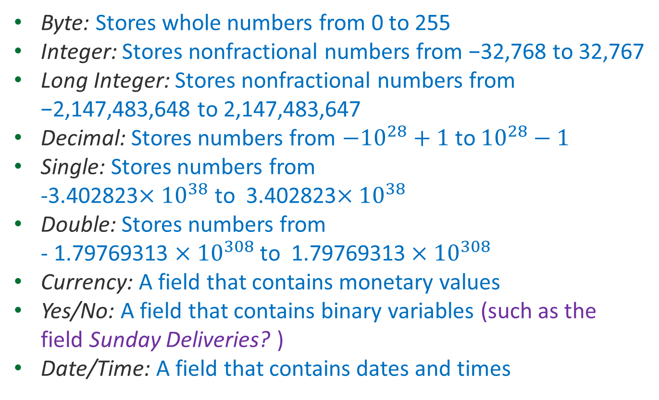
2. Table – Data Type
Byte: Stores whole numbers from 0 to 255
Integer: Stores nonfractional numbers from −32,768 to 32,767
Long Integer: Stores nonfractional numbers from −2,147,483,648 to 2,147,483,647
Decimal: Stores numbers from $$−{10}^{28}+1$$ to $${10}^{28}−1$$
Single: Stores numbers from -3.402823$${×10}^{38}$$ to 3.402823$${×10}^{38}$$
Double: Stores numbers from - 1.79769313 $${×10}^{308}$$ to 1.79769313$${×10}^{308}$$
Currency: A field that contains monetary values
Yes/No: A field that contains binary variables (such as the field Sunday Deliveries? )
Date/Time: A field that contains dates and times

Slide 27
3. Associations Among Tables
One database can hold many tables which hold different kinds of data
Data can be linked between tables
The link between tables is called a RELATION
Table A
Table B

Slide 28
3.1 Primary Key (PK)
A column (or a combination of columns) of a table that uniquely identifies a row of the table
It is used to identify how records from several tables in a database are logically related
Properties of PKs:
Every row has a different value
It cannot be NULL
PKs are typically underlined
Customers
CustomerID | CompanyName | City
ALFKI | Alfreds Futterkiste | Berlin
ANATR | Ana Trujillo Emparedados y helados | México D.F.
ANTON | Antonio Moreno Taquería | México D.F.
AROUT | Around the Horn | London
*note that two customers could have the same company name

Slide 29
3.2 Foreign Key
Customers
CustomerID | CompanyName | City
ALFKI | Alfreds Futterkiste | Berlin
ANATR | Ana Trujillo Emparedados y helados | México D.F.
ANTON | Antonio Moreno Taquería | México D.F.
Orders
OrderID | CustomerID | OrderDate
10643 | ALFKI | 8/25/1997
10625 | ANATR | 8/8/1997
10677 | ANTON | 9/22/1997
10682 | ANTON | 9/25/1997
The association between these tables is implemented through the match between:
Customers.CustomerID and
Orders.CustomerID
Orders.CustomerID is a foreign key pointing to Customers.CustomerID

Slide 30
3.2 Foreign Key
A foreign key is an attribute of a table that “points” to a primary key of another table (referenced table)
When a field is included in a table for the sole purpose of facilitating links with records from another table, the field called a foreign key field
That is, its values must be picked from the values of the primary key in the referenced table

Slide 31

3.3 Entity Relationship Diagram
Entity-Relationship (ER) diagram: a stylized diagram of a database
Customers
- CustomerID
- CompanyName
- City
Orders
- OrderID
- CustomerID
- OrderDate
Have made
1
$$∞$$

Slide 32

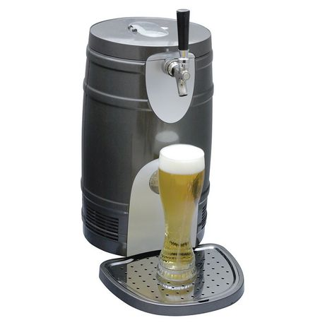
Illustration – Stinsons.accdb
Stinson’s MicroBrew Distributor
Stinson’s provides
Refrigerated storage
Transportation
Delivery to retailers
of premium beers produced by several microbreweries
Stinson’s monitors the retailer’s shelves, taps, and keg lines to ensure the freshness and quality of the product

Slide 33
Illustration – Stinsons.accdb
Stinson’s also employs sales, receiving, warehousing/inventory, and delivery personnel
The company’s management team has identified three broad key areas of data management:
personnel (information on Stinson’s employees);
supplier (information on purchases of beer made by Stinson’s from its suppliers); and
retailer (information on sales to Stinson’s retail customers).

Slide 34
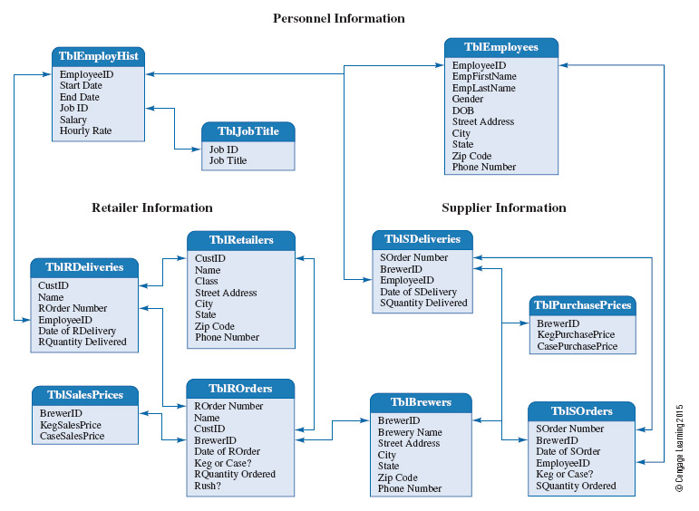
Stinsons.accdb

Slide 35
Use of the Database
Warehousing/inventory – monitor and control inventory
Delivery – create efficient delivery routes for the drivers
Receiving – prepare to receive daily deliveries
HR – administer payroll, taxes, and benefits
Marketing – identify and exploit potential sales opportunities

Slide 36
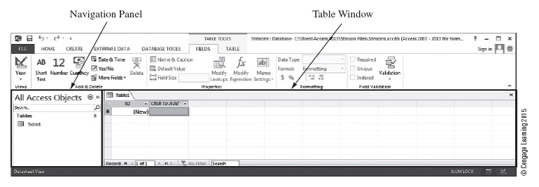
Datasheet View and Table Tools Contextual Tab
In Datasheet view the data are entered by field, one record at a time.

Slide 37
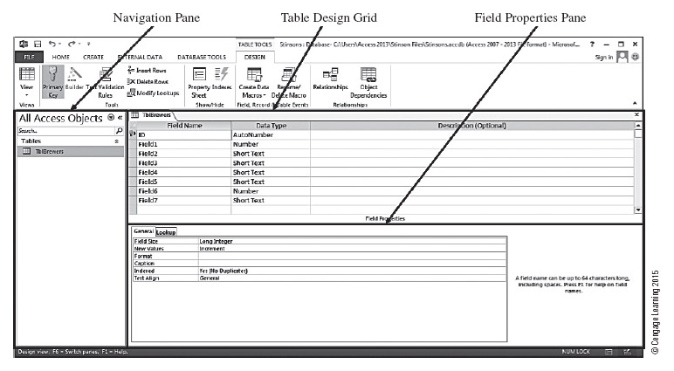
Design View for the Table TblBrewers
Use the Design view to provide meaningful names for our fields and specify each field’s properties.

Slide 38
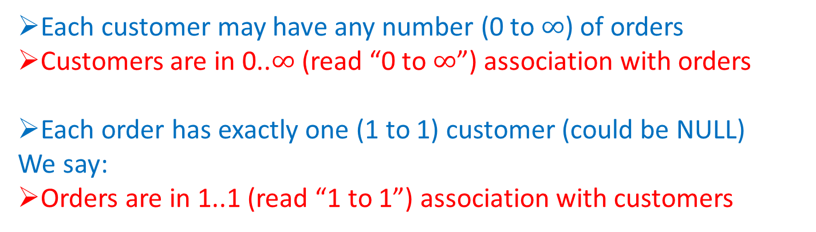
Association
Customers
CustomerID | CompanyName | City
ALFKI | Alfreds Futterkiste | Berlin
ANATR | Ana Trujillo Emparedados y helados | México D.F.
ANTON | Antonio Moreno Taquería | México D.F.
Orders
OrderID | CustomerID | OrderDate
10643 | ALFKI | 8/25/1997
10625 | ANATR | 8/8/1997
10677 | ANTON | 9/22/1997
10682 | ANTON | 9/25/1997
What is the association between Customers and Orders?
Each customer may have any number (0 to $$∞$$) of orders
Customers are in 0..$$∞$$ (read “0 to $$∞$$”) association with orders
Each order has exactly one (1 to 1) customer (could be NULL)
We say:
Orders are in 1..1 (read “1 to 1”) association with customers

Slide 39
Rules of Integrity
Entity integrity: the table will have no duplicate records
Defining a primary key field ensures the entity integrity
Referential integrity
When the foreign key field in one table (say, Table B) and the primary key field in the other table (say, Table A) are matched, each value that occurs in the foreign key field in Table B must also occur in the primary key field in Table A.
Customers
- CustomerID
- CompanyName
- City
Orders
- OrderID
- CustomerID
- OrderDate
Have made

Slide 40
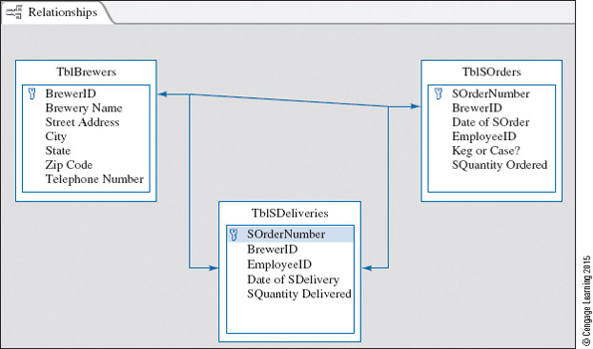
Exercise Time

Slide 41
More Discussions about Relationship
In the previous example of Stinsons.accdb, both of the two tables have SOrderNumber as the primary key
One-to-one relationship → Combine them as one table?
A more realistic situation is where a separate set of Delivery Numbers is needed to maintain the delivery records.
In this case, a relational database makes more sense
(1 : 1)
(0 : 1)

Slide 42
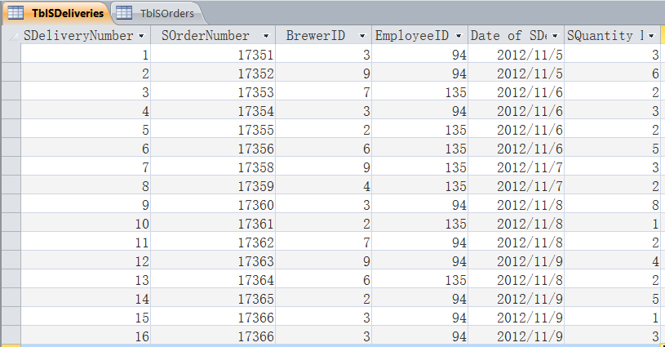
More Discussions about Relationship
The new TblsSDeliveries Table showing all the orders delivered by those microbrewer suppliers (what is shown below may differ from the given database file)
One order is handled by separate deliveries.

Slide 43
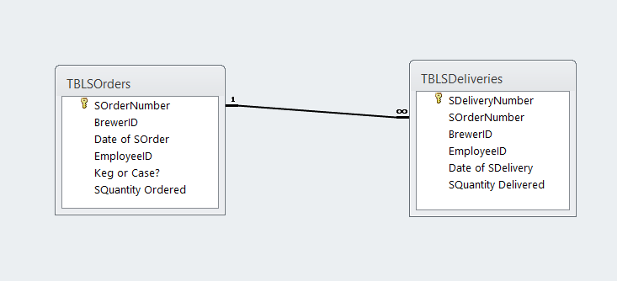
More Discussions about Relationship
What is the relationship between the two tables?
(what is shown below may differ from the given database file)
?
?

Slide 44
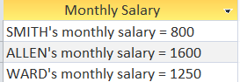
3.1 Literal Character Strings
Try yourself:
Display results like:
SELECT ENAME & “’s monthly salary = " & SAL AS [Monthly Salary]
FROM empT;
space

Slide 45
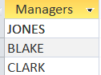
5. WHERE Clause
The same can be done for text columns. Generally, with text columns, stick to equal or not equal to, and make sure that any text that appear in the statement is surrounded by single quotation marks.
Try yourself:
Display the employee names of all MANAGER, and name the column as ‘Managers’.
SELECT ENAME AS Managers
FROM empT
WHERE JOB = 'MANAGER';
3 rows selected.

Slide 46
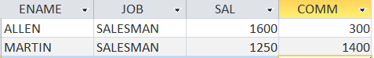
AND & OR can be combined
Try yourself:
Display the name, job, salary and commission of all SALESMAN who made salary greater than $1,500 or had commission greater than $1,000.
SELECT ENAME, JOB, SAL, COMM
FROM empT
WHERE JOB = 'SALESMAN' AND (SAL > 1500 OR COMM > 1000);
2 rows selected.

Slide 47
Exercise
Create a table showing job titles and the average salary of each job title. However, when you compute the average, exclude the employees who belong to the department 30. Show only those job titles whose computed average salary is greater than or equal to 1100.
Also correct:
SELECT job, AVG(sal)
FROM empT
WHERE deptno = 20 OR deptno = 10
GROUP BY job
HAVING AVG(sal) >= 1100;
SELECT job, AVG(sal)
FROM empT
WHERE deptno <> 30
GROUP BY job
HAVING AVG(sal) >= 1100;

Slide 48
Exercise
To the contract table, add a contract #7 which has no employee in charge.
Write a query that returns all contracts, showing the contract number, the employee number in charge, the job title of the employee, and the department number.
SELECT contractno, empT.empno, empT.job, empT.deptno
FROM contractT
LEFT JOIN empT
ON contractT.empno=empT.empno;

Slide 49
OM 420/620 Predictive Business Analytics Lecture 3 Basics in SQL Part 1 Prof. ILBIN LEE

Slide 50
Learning Objectives
Basic SELECT Statement 1.1 Terms 1.2 Some Guidelines 1.3 Selecting All Columns 1.4 Selecting Specific Columns 1.5 Column Heading Defaults
Arithmetic Expressions 2.1 Defining a Column Alias 2.2 Arithmetic Operator Precedence 2.3 Defining a Null Value

Slide 51
Learning Objectives
Concatenation Operator & 3.1 Literal Character Strings
Eliminating Duplicate Rows
WHERE Clause 5.1 Relational Operators 5.2 Logical Operators 5.3 Aggregate Functions

Slide 52
Structured Query Language (SQL)
SQL is a standard language for storing, manipulating and retrieving data in database
MySQL, SQL Server, MS Access, Oracle, …
SQL became a standard of the International Organization for Standardization (ISO) in 1987
Despite the existence of such standards, there are some differences in SQL syntax among different database systems

Slide 53
1. Basic SELECT Statement
In its simplest form, a SELECT statement must include:
A SELECT clause, which specifies the columns to be displayed.
A FROM clause, which specifies the table containing the columns listed in the SELECT clause.
Data file: Employee Data.accdb
This database contains one table only: empT

Slide 54
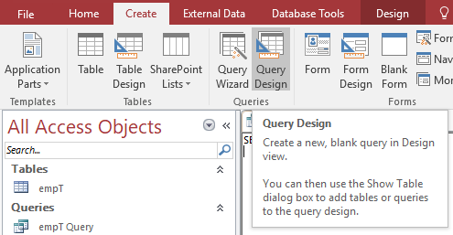
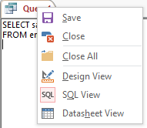
Basic Interface for Query
To create a new query, select Query Design in Create tab
To change the view of a query, right click on the title and choose a view you want

Slide 55
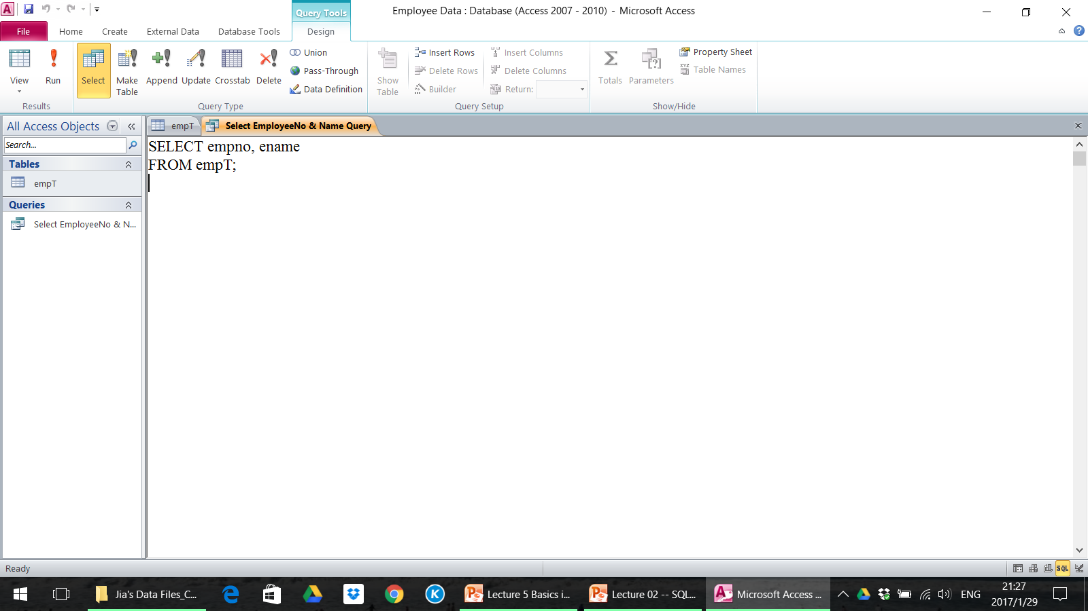
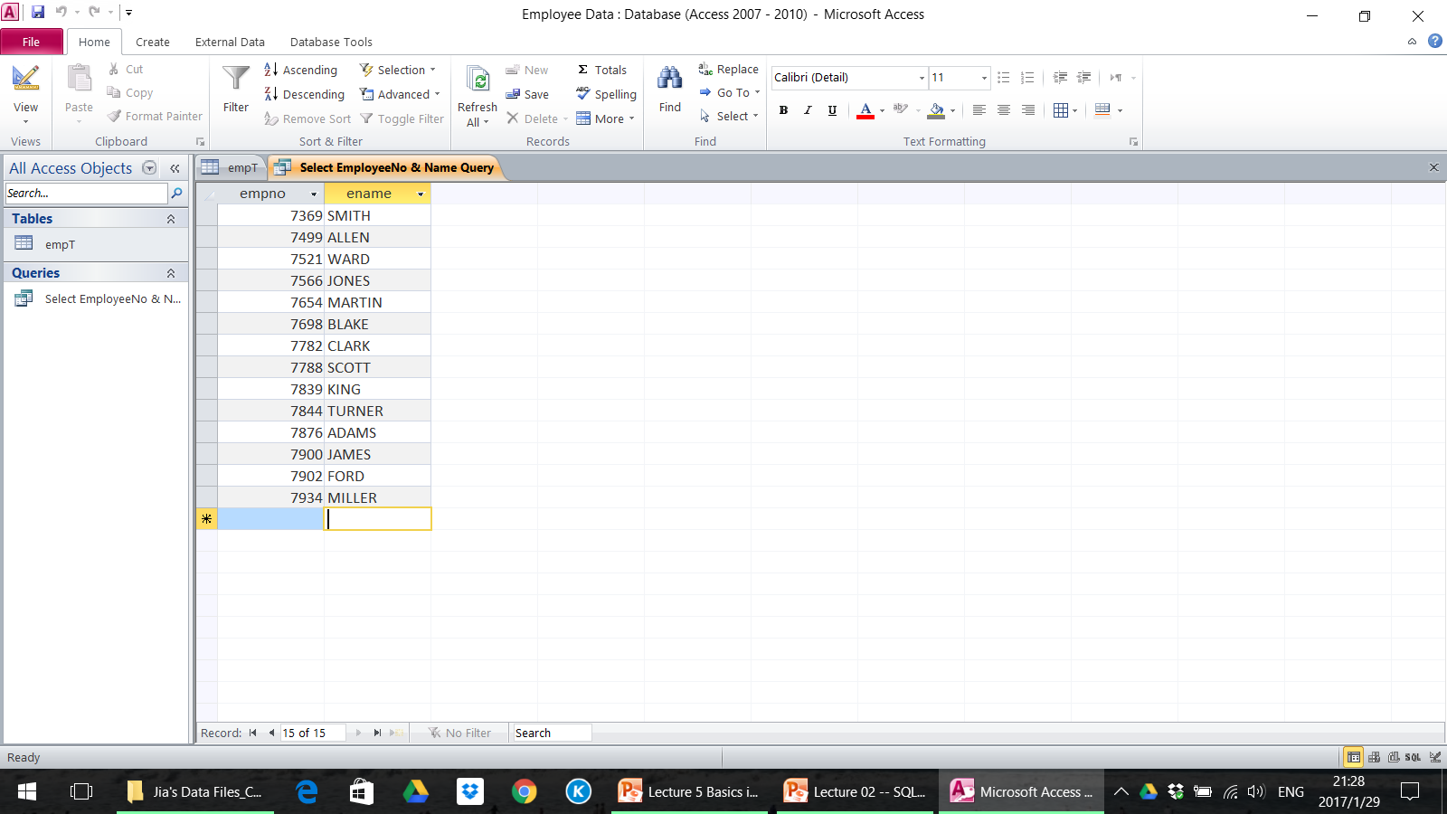
1. Basic SELECT Statement
SELECT the columns of “empno” and “ename” FROM the table “empT”
Note: Running a query does not add a table to a database, but only displays the result

Slide 56
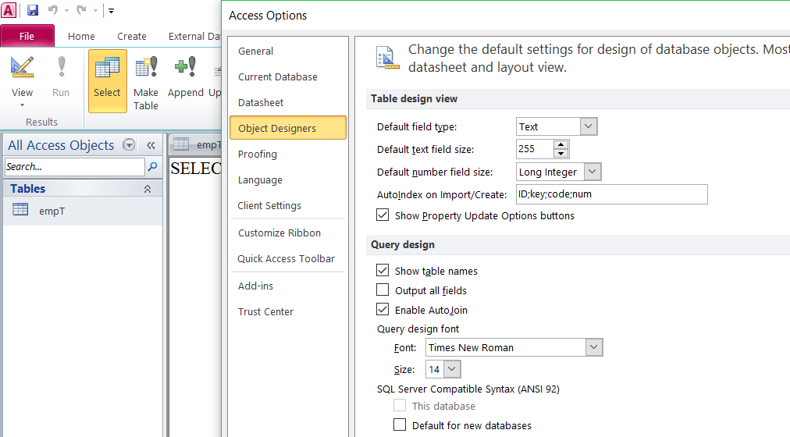
Adjusting the Query Design Font Size
1
2
3

Slide 57
1.1 Terms
Throughout this lecture, the words keyword, clause, and statement are used:
A keyword refers to an individual SQL element - For example, SELECT and FROM are keywords
A clause is part of an SQL statement - For example, ‘SELECT empno, ename’ is a clause
A statement or a query is a combination of two or more clauses - For example, ‘SELECT * FROM empT’ is a SQL statement

Slide 58
1.2 Some Guidelines
Syntax
SQL statements are not case sensitive, unless indicated
Keywords cannot be split across lines or abbreviated
Place a semicolon (;) at the end of the last clause (not required any more)
Style guide
SQL statements can be entered on one or many lines
Clauses are usually placed on separate lines for readability and ease of editing
Tabs and indents can be used to make code more readable
Keywords typically are entered in uppercase; all other words, such as table names and columns, are entered in lowercase

Slide 59
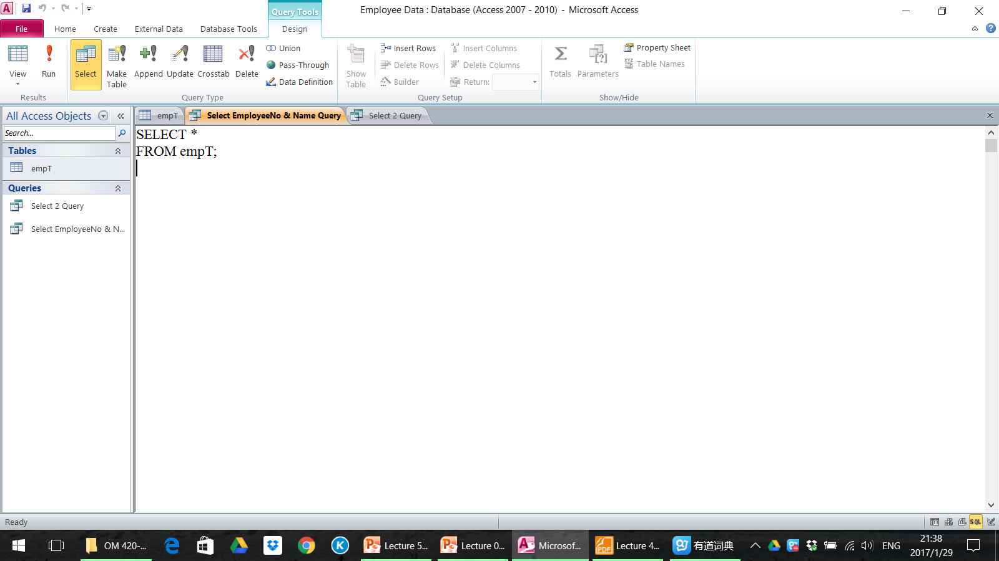
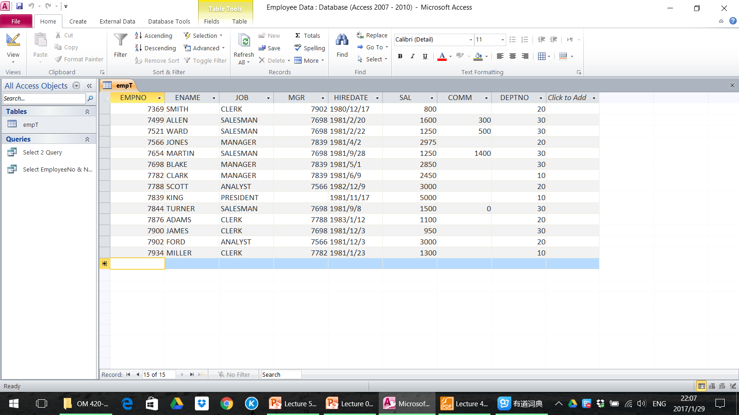
1.3 Selecting All Columns
You can display all columns of data in a table by following the SELECT keyword with an asterisk (*)
14 rows selected.

Slide 60
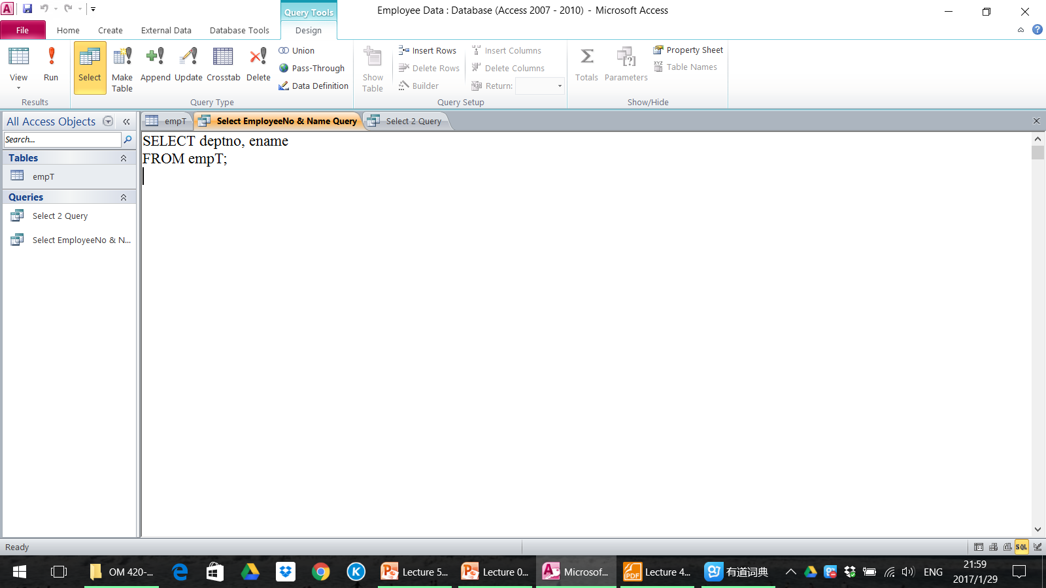
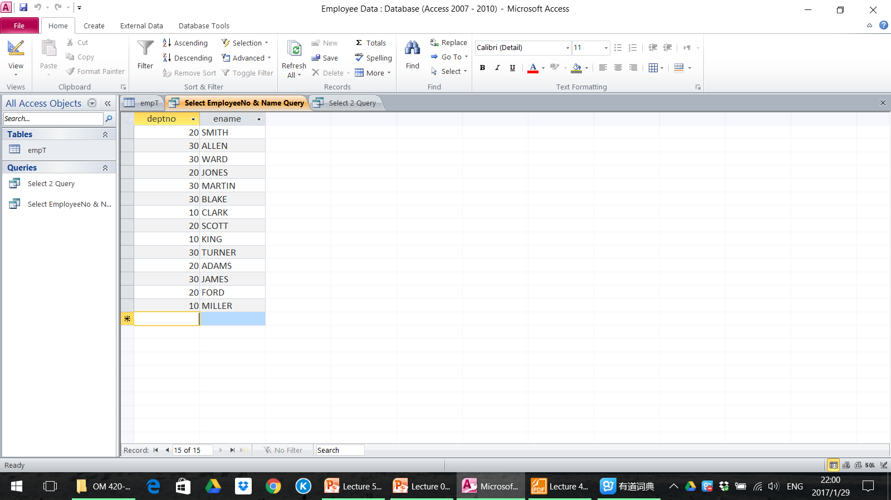
1.4 Selecting Specific Columns, All Rows
You can use the SELECT statement to display specific columns of the table by specifying the column names, separated by commas
Specify the columns that you want to see, in the order in which you want them to appear in the output
deptno is displayed before ename.

Slide 61
1.5 Column Heading and Alignment
Default justification
Left: Date and character data
Right: Numeric data
Default display: Uppercase

Slide 62
2. Arithmetic Expressions
Operator | Description
+ | Add
- | Subtract
* | Multiply
/ | Divide
You may need to modify the way in which data is displayed, perform calculations, or look at what-if scenarios. This is possible using arithmetic expressions
An arithmetic expression may contain column names, constant numeric values, and the arithmetic operators
You cannot use arithmetic operators in the FROM clause

Slide 63
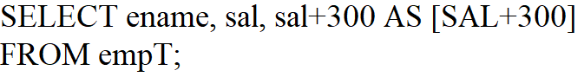
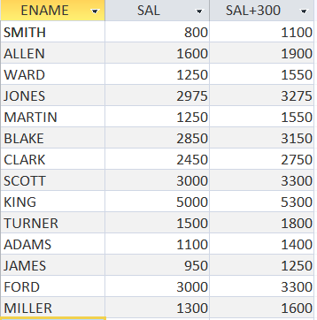
Arithmetic Expressions
sal+300: to calculate a salary increase of $300 for all employees
The new column is not added in the empT table – it is for display only

Slide 64
2.1 Alias
Alias: gives selected columns different headings
SELECT … AS …
Requires brackets [ ] if it contains spaces or special characters

Slide 65
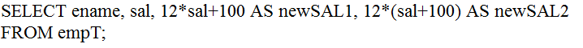
2.2 Arithmetic Operator Precedence
* | / | + | -
Multiplication and division take priority over addition and subtraction
Operators of the same priority are evaluated from left to right
Parentheses are used to force prioritized evaluation and to clarify statements
Compare the two:

Slide 66
Closing MS Access
When you close MS Access, if there is any unsaved objects (for example, any unsaved query or any table with unsaved changes), a dialog box will appear for each one asking if you would like to save it.
After choosing yes or no for all unsaved objects, you can close the database.

Slide 67
2.3 Defining a Null Value
A null is a value that is unavailable, unassigned, unknown, or inapplicable
If a row lacks the data value for a particular column, that value is said to be null
A null is not the same as zero or a blank space. Zero is a number, and a space is a character
Columns of any datatype can contain null values, unless the column was defined as NOTNULL or as PRIMARY KEY when the column was created
Arithmetic expressions containing a null value evaluate to null

Slide 68
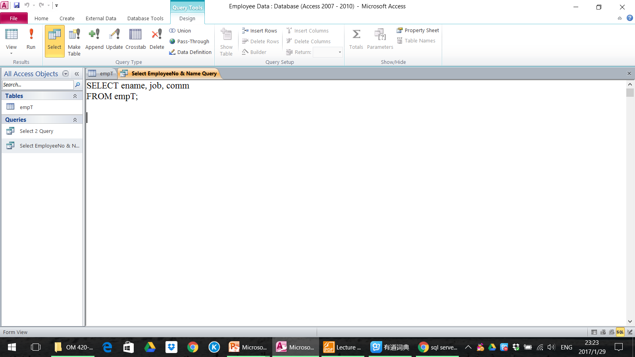
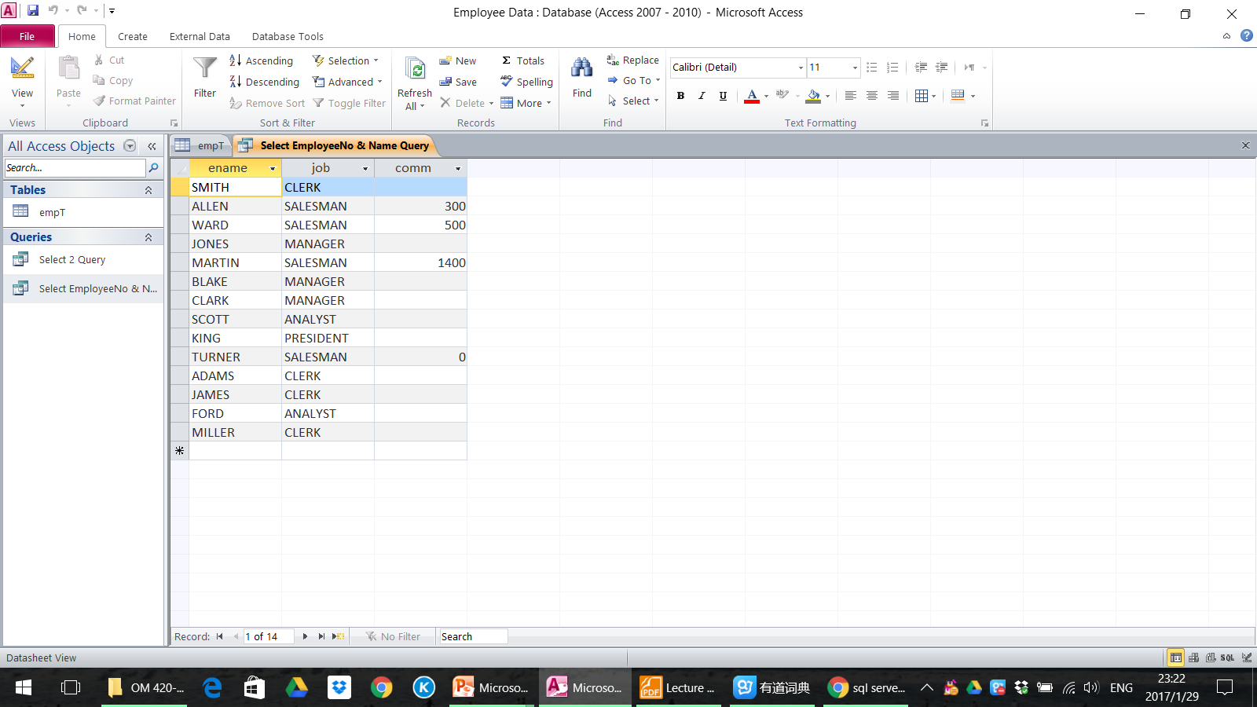
2.3 Defining a Null Value
In the COMM column in the empT table, only a SALESMAN can earn commission
Other employees are not entitled to earn commission – A null value represents that fact
Turner, who is a salesman, does not earn any commission
Notice that his commission is zero and not null

Slide 69
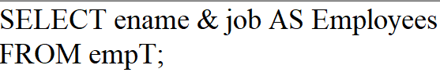
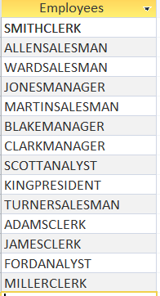
3. Concatenation Operator

Slide 70
3. Concatenation Operator
Link columns or character strings to other columns → Columns on either side of the operator are combined to make a single output column
Is represented by the & operator
Creates a resultant column that is a character expression

Slide 71
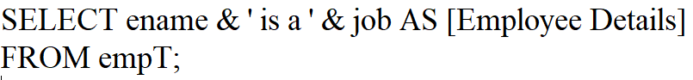

3.1 Literal Character Strings
The spaces improve the readability of the output

Slide 72
3.1 Literal Character Strings
A literal is a character, expression, or number included in a SELECT clause
Character literal values must be enclosed within single quotation marks (‘ ’)
If the literal values include ’, the double quotation marks (“ ”) is used
Each character string is output once for each row returned

Slide 73
3.1 Literal Character Strings
Try yourself:
Display results like:

Slide 74
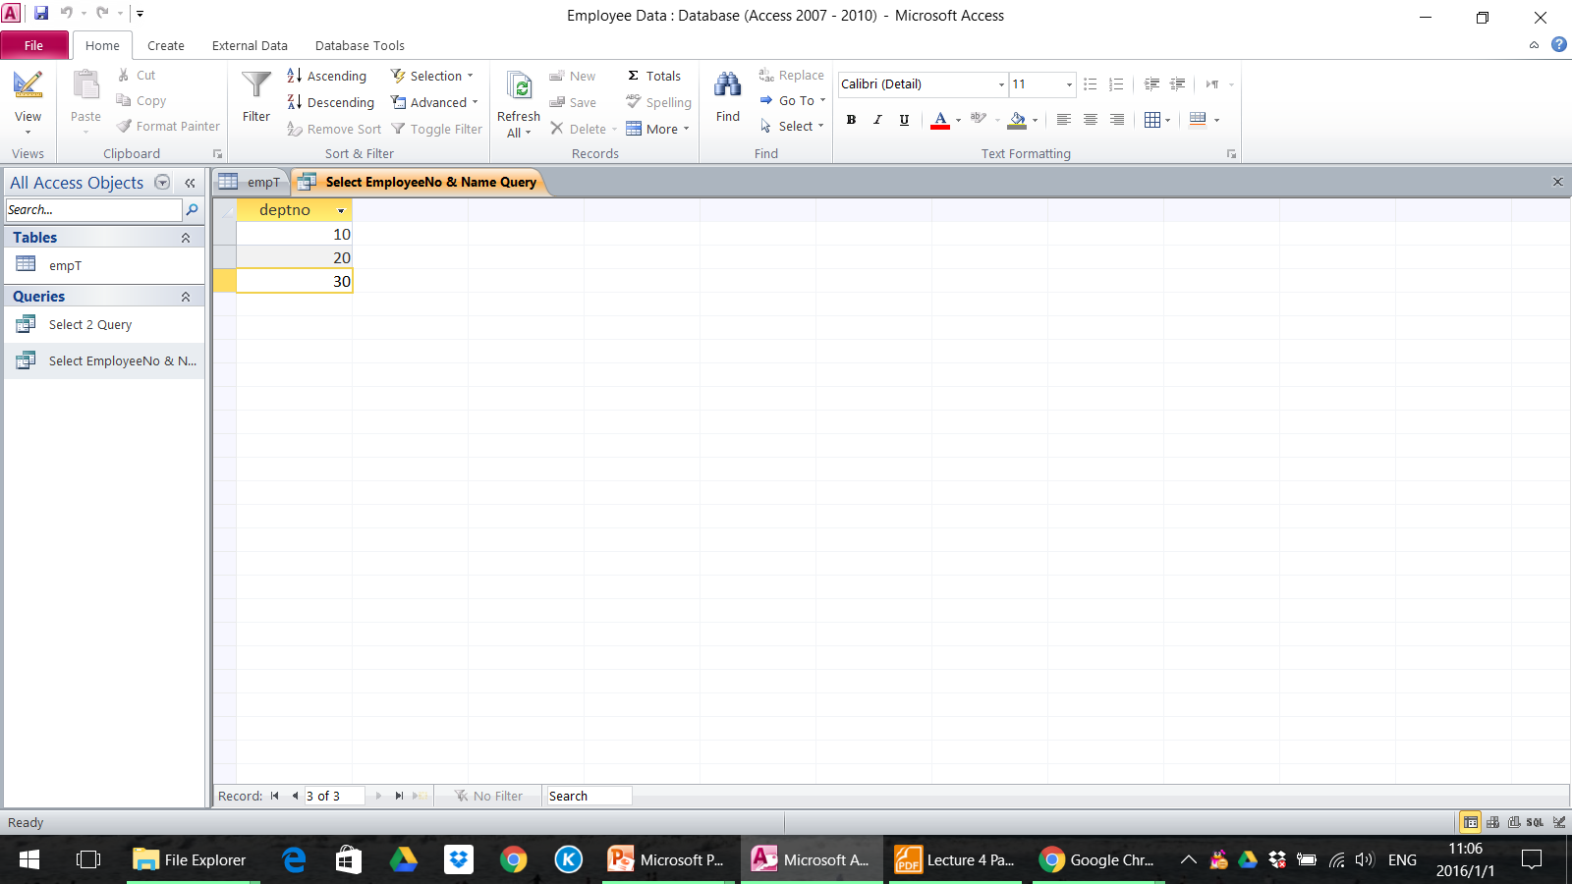
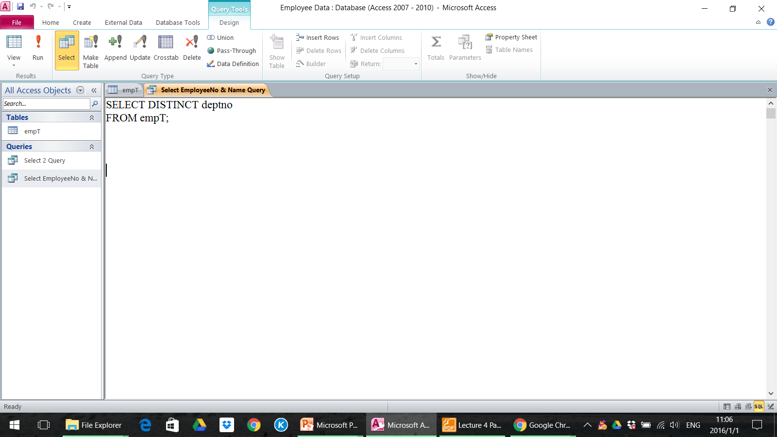
4. Not Showing Duplicate Rows
The default display of queries is all rows, including duplicate rows
Eliminate duplicate rows by including the DISTINCT keyword in the SELECT clause immediately after the SELECT keyword

Slide 75

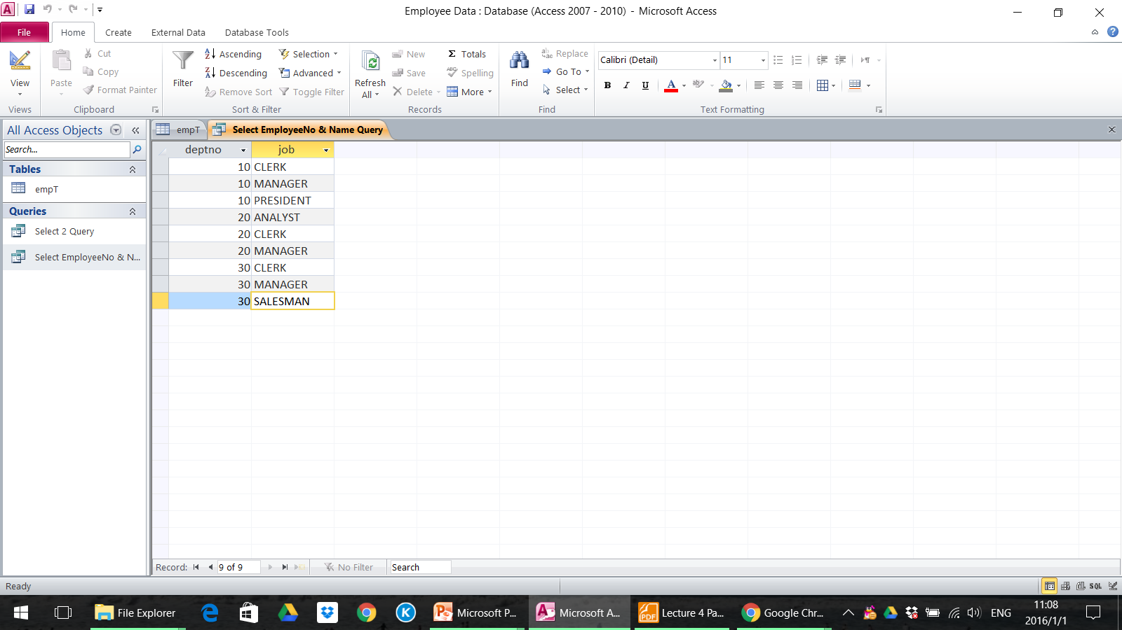
4. Not Showing Duplicate Rows
You can specify multiple columns after the DISTINCT qualifier
It affects all the selected columns, and the result represents a distinct combination of the columns

Slide 76
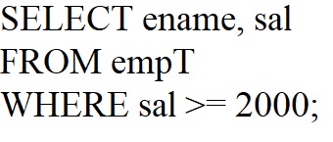
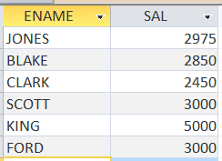
5. WHERE Clause
The WHERE clause is used to specify that only certain rows of the table are displayed, based on the criteria described in that WHERE clause
SAL >= 2000 is known as a condition (an operation which evaluates to True or False)

Slide 77
5. WHERE Clause
The same can be done for text columns
Make sure that any text that appear in the statement is surrounded by single quotation marks
Not case sensitive
Date should be surrounded by #
Try yourself:
Display the employee names of all MANAGER, and name the column as ‘Managers’.

Slide 78
5.1 Relational Operators
Operator | Description
= | Equal
<> | Not Equal/ Different From
< | Less Than
> | Greater Than
<= | Less Than or Equal To
>= | Greater Than or Equal To
LIKE | Strings where wildcards are used

Slide 79
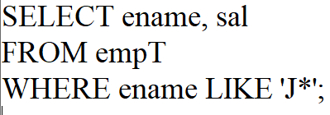
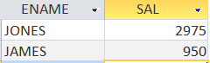
LIKE
Wildcard symbol *
Display the name and salary of all people whose name starts with “J”
Not case-sensitive

Slide 80
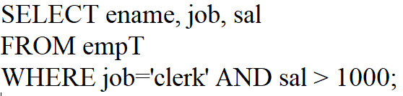
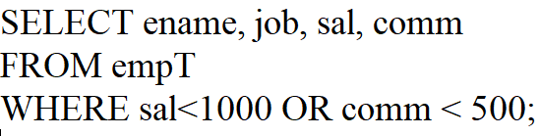
AND; OR
Display all Clerks making Salaries over $1,000.
Display those who made Salaries less than $1,000 or had commission less than $500.

Slide 81
AND & OR can be combined
Try yourself:
Display the name, job, salary and commission of all SALESMAN who satisfy one of the below conditions:
made salary greater than $1,500 or
had commission greater than $1,000.

Slide 82
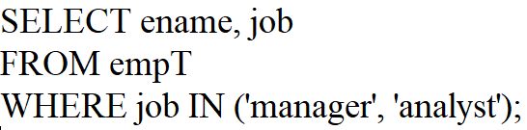
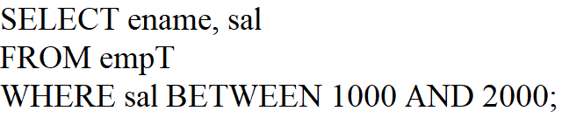
IN or BETWEEN
Display the name and job of all Managers and Analysts.
This is an interval representing the range from which the salary is selected
Display the name of those making salary greater than or equal to $1,000 but less than or equal to $2,000.

Slide 83
5.2 Logical Operators
Operator | Description
AND | Joins two or more conditions, and displays a row only if that row’s data satisfies ALL conditions listed (i.e. all conditions hold true)
OR | Joins two or more conditions, but returns a row if ANY of the conditions listed hold true.
IN or BETWEEN | An easier method of using compound conditions.
NOT | NOT is used with other operators. E.g. NOT BETWEEN, NOT IN
SQL Order of Logical Operations (each operates from left to right)
NOT
AND
OR

Slide 84
5.3 Aggregate Functions
Functions | Description
SUM( ) | Gives the total of all the rows, satisfying any conditions, of the given column, where the given column is numeric.
AVG( ) | Gives the average of the given column.
MAX( ) | Gives the largest figure in the given column.
MIN( ) | Gives the smallest figure in the given column.
COUNT(*) | Gives the number of rows satisfying the conditions.
COUNT(<column>) | Gives the number of rows for which the column is not NULL

Slide 85
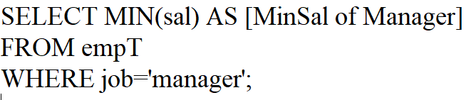
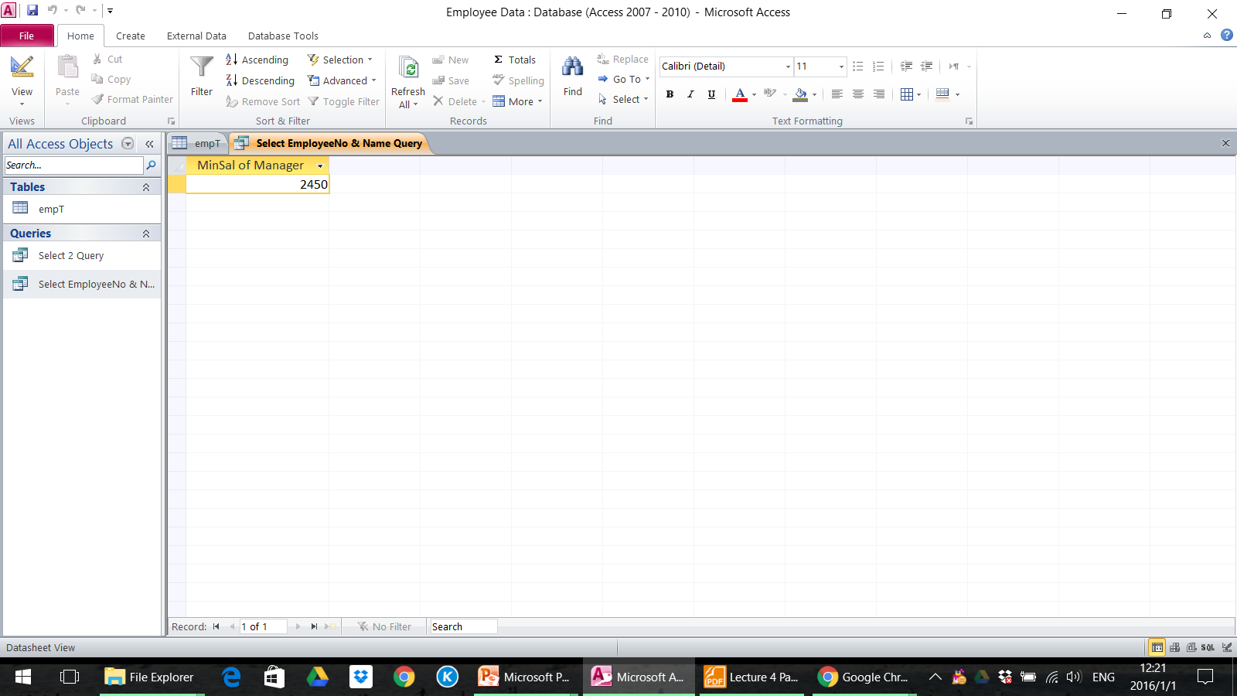
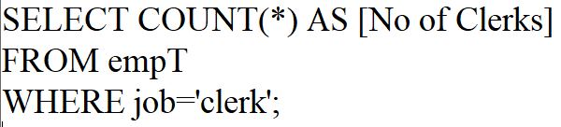
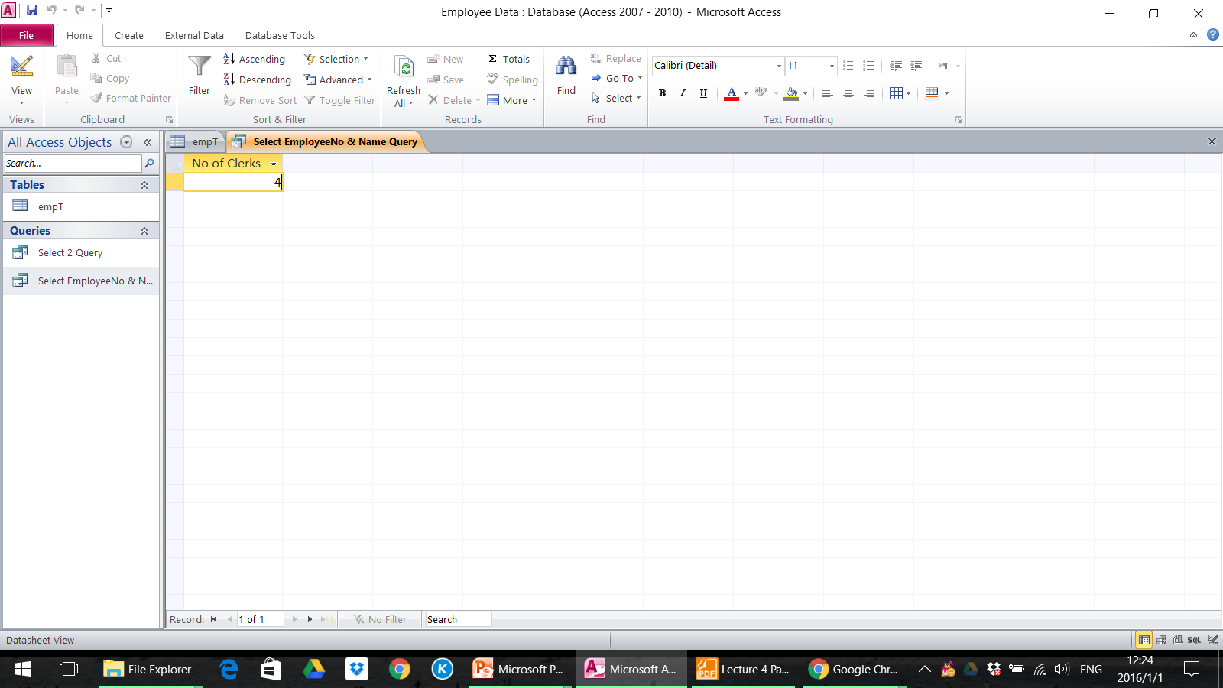
Aggregate Functions Examples
Display the minimum salary of Managers.
Display how many employees have Clerk status.

Slide 86
Saving Data to External Files
Access can export data to external files in formats that are compatible with a wide variety of software
Exporting information to an external file is particularly useful when applied to tables that have been linked or to query results
Exporting information from a relational database such as Access to Excel allows one to apply various tools and techniques to a subset of a large data set. This can be much more efficient than trying to use Excel to clean and filter large data sets.

Slide 87
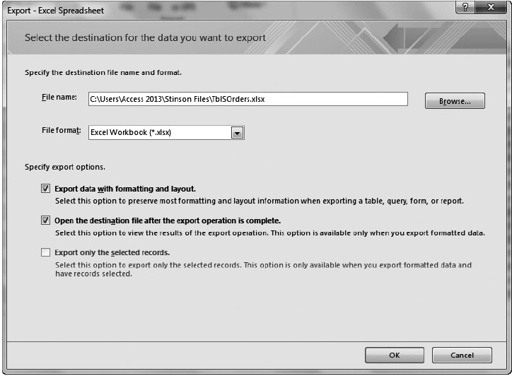
Saving Data to External Files

Slide 88
OM 420/620 Predictive Business Analytics Lecture 3 Basics in SQL Part 2 Prof. ILBIN LEE

Slide 89
Learning Objectives
Display by rules 6.1 GROUP BY & HAVING 6.2 ORDER BY
Change the table contents and the database 7.1 INSERT INTO 7.2 UPDATE 7.3 DELETE 7.4 INTO
JOINS
UNION
CREATE TABLE

Slide 90
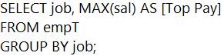
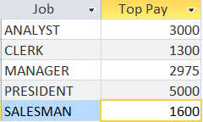
6.1 GROUP BY & HAVING
GROUP BY is used with an aggregate function (COUNT, MAX, etc) to compute the value for groups of rows.
For example, to show the highest monthly salary of each job category:

Slide 91
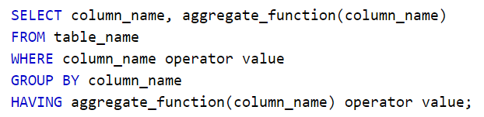
6.1 GROUP BY & HAVING
HAVING specifies a search condition for a group or an aggregate function used in SELECT statement.
HAVING is used to check conditions after the aggregation takes place.
WHERE is used before the aggregation takes place.
The basic syntax of HAVING clause is as follows:

Slide 92

6.1 GROUP BY & HAVING
For example, to show the highest monthly salary of various jobs and display those greater than $2,000:
SELECT job, MAX(sal) AS [Top Pay]
FROM empT
GROUP BY job
HAVING MAX(sal)>2000;
(You can copy and paste)

Slide 93
Exercise
Create a table showing job titles and the average salary of each job title. However, when you compute the average, exclude the employees who belong to the department 30. Show only those job titles whose computed average salary is greater than or equal to 1100.

Slide 94

6.2 ORDER BY
The ORDER BY clause is used to sort the data in ascending or descending order, based on one or more columns. Some database systems (including Access) sort query results in ascending order by default.
For example, to show a list of job titles, employee names and their salary where the list is alphabetized by Job titles and then sorted by salary:

Slide 95

6.2 ORDER BY
The basic syntax of ORDER BY clause is as follows (in Access, ASC is default):
* ORDER BY n: ordering by the nth column
Ex) ORDER BY 3: ordering by the third column

Slide 96
7.1 INSERT INTO
The INSERT INTO statement is used to insert new records in a table.
For example, to insert the following two records:

Slide 97


7.1 INSERT INTO
The INSERT INTO statement is used to insert new records in a table.
It is possible to write the INSERT INTO statement in two forms:
Does not specify the column names where the data will be inserted, only their values
Specifies both the column names and the values to be inserted

Slide 98


7.2 UPDATE
The UPDATE command can be used to change some of the values of columns of a table
For example, to change the monthly salary for employee 7369 (who is Smith) by adding $300:
If the empno data type is Number
Text

Slide 99

7.2 UPDATE
Changes are provided as a comma-separated list of column/value pairs.
The basic syntax of UPDATE clause is as follows:
Notice the WHERE clause in the SQL UPDATE statement!
The WHERE clause specifies which record or records that should be updated. If you omit the WHERE clause, all records will be updated!

Slide 100


7.3 DELETE
The DELETE statement is used to delete records in a table.
For example, to delete a record whose name is ‘Xiaojia’:
Notice the WHERE clause in the SQL DELETE statement! The WHERE clause specifies which record or records that should be deleted. If you omit the WHERE clause, all records will be deleted!

Slide 101
7.4 INTO
The INTO keyword is used to create a new table from a query result
SELECT empno, ename
INTO empNameJT
FROM empT
WHERE ename LIKE 'J*';

Slide 102
8. Joins
Data file: Employee Data2.accdb
A JOIN clause is used to combine rows from two or more tables, based on a common field between them.
Different types of JOINs:
INNER JOIN: Returns all rows when there is at least one match in BOTH tables
LEFT JOIN: Return all rows from the left table, and the matched rows from the right table
RIGHT JOIN: Return all rows from the right table, and the matched rows from the left table
FULL JOIN: Return all rows when there is a match in ONE of the tables

Slide 103

(1) INNER JOIN
For example, to show the responsible employees for different sales contract and their corresponding managers:
SELECT contractT.contractno, empT.empno, empT.mgr
FROM empT
INNER JOIN contractT
ON empT.empno=contractT.empno;
(You can copy and paste)
Note: If a column belongs to only one of the tables, then you may omit the table name in front of the column name

Slide 104


(1) INNER JOIN
The INNER JOIN keyword matches rows from the left table (table1) and rows in the right table (table2) and returns only those matched rows
(updated Sep 16, 2020)

Slide 105


(2) LEFT JOIN
The LEFT JOIN keyword returns all rows from the left table (table1), with the matching rows in the right table (table2).
The result is NULL in the right side when there is no match.
In some databases LEFT JOIN is called LEFT OUTER JOIN.

Slide 106

(2) LEFT JOIN
For example, to show ALL employees with different sales contracts and their corresponding managers:
SELECT empT.empno, contractT.contractno, empT.mgr
FROM empT
LEFT JOIN contractT
ON empT.empno=contractT.empno;
(You can copy and paste)
For each row in empT, all matching rows in contractT are displayed
All records in empT table are returned.

Slide 107


(3) RIGHT JOIN
The RIGHT JOIN keyword returns all rows from the right table (table2), with the matching rows in the left table (table1).
The result is NULL in the left side when there is no match.
In some databases RIGHT JOIN is called RIGHT OUTER JOIN.

Slide 108

(4) FULL OUTER JOIN
The FULL OUTER JOIN
Returns all rows from the left table (table1) and from the right table (table2)
Combines the result of both LEFT and RIGHT joins
Not supported in MS Access

Slide 109
Exercise
Write a query that returns all contracts, showing the contract number, the employee number in charge, the job title of the employee, and the department number.

Slide 110
UPDATE with JOIN – changing in batch
You can make a batch of changes to your database by combining UPDATE and JOIN
Import “Employee Data2 Contract Change.xlsx” as changeT
Run the following query in which UPDATE and JOIN are combined
UPDATE contractT
INNER JOIN changeT
ON contractT.contractno = changeT.contractno
SET contractT.empno = changeT.empno;
(You can copy and paste)

Slide 111

9. UNION
Access does not explicitly support FULL OUTER JOIN, but you can achieve the same effect by using a UNION query.
The UNION operator is used to combine the result-set of two or more SELECT statements.
Notice that each SELECT statement within the UNION must have the same number of columns. The columns must also have similar data types. Also, the columns in each SELECT statement must be in the same order.

Slide 112


9. UNION
For example, to combine the empT and contractT tables:
The UNION operator selects only distinct values by default. To allow duplicate values, use UNION ALL.

Slide 113

10. CREATE TABLE
The CREATE TABLE statement is used to create a table in a database.
Tables are organized into rows and columns; and each table must have a name.

Slide 114

10. CREATE TABLE
For example, to create a table named customerT3 containing customers’ IDs, names, and mobile numbers:
Data type:
Integer
Character string. Maximum length 255 bytes
Character string. Maximum length 20 bytes

Slide 115

OM 420/620 Prescriptive Business Analytics Lecture 4 Introduction to R Part 1

Slide 116
Learning Objectives
R and RStudio
Running R codes
Data types
Workspace
Packages
Reading and writing data files

Slide 117

Popular Tools for Data Analytics
“They are fighting to become data scientists’ language of choice”
R focuses on data analysis, statistics, and graphical models

Slide 118
R
A software package suitable for data analysis and graphical representation
Free and open source
Implementation of many modern statistical methods
Flexible and customizable

Slide 119

Getting R
Go to https://www.r-project.org/
Click on CRAN under Download
Select a CRAN mirror location close to you or let it decide for you
A good introduction to R is available at http://www.cran.r-project.org/ https://www.rdocumentation.org/

Slide 120

RStudio

Slide 121
What is RStudio?
RStudio is an environment where you can work with R in a more convenient way
You can interact with R by writing code in the Console window
You can also write your R codes in an R Script in the source window and then execute your R codes in Console

Slide 122

Download RStudio
Go to https://posit.co/download/rstudio-desktop/
and download the latest version of Rstudio

Slide 123
Your Turn
Type `1 + 2` in the Console; press Enter
Open an R script
Now type `1 + 2` in the R script; press Enter

Slide 124
Executing Code (Windows)
'ctrl + shift + enter' will execute all the codes in the script
'ctrl + enter' will execute the line of code that the cursor is on and will move the cursor to the next line
You can execute a chunk of code by highlighting the code and pressing 'ctrl + enter'
For Mac, use `cmd` instead of `ctrl`

Slide 125
In the Console
`ctl + l` will clear the Console
`up` will go through your code history
Entering the first parts of a code and then pressing `cmd/ctrl + up` will go through the history of past codes beginning with that initial part
Entering the first part of a function and then pressing `tab` will complete the name of the function or will list functions that start with that part (works also in Script)

Slide 126
Try These in the Console
44-11
5*11
2^3
98/9
98%/%9
98%%9

Slide 127
Try These in the Console (Comparisons)
3>5
3<5
2>=2
7<=5
2 == 4/2
3!=4

Slide 128
Your Turn
Write an expression that will return either TRUE or FALSE as the answer to the following questions:
1. Is the remainder of 1234 divided by 234 bigger than 100?
2. Is the remainder of 1234 divided by 234 even?
3. Is 2^3^2 different than (2^3)^2?

Slide 129
Boolean Operators
Try these:
(3 < 5) & (7*6 == 42)
(3 == 5) | (7*6 == 42)

Slide 130
Data Types
Booleans: direct binary values, TRUE or FALSE in R
Characters: fixed-length blocks of bits, with special coding
Strings: sequences of characters
Integers
Floating point numbers: a fraction (with a finite number of bits) times an exponent, like 1.87*10^6
Missing or ill-defined values: NA, NaN, etc.

Slide 131
Try the following
typeof(7)
is.numeric(7)
is.na(7)
is.na(7/0)
is.na(0/0)
is.character(7)
is.character("7")
is.character("seven")
is.na("seven")

Slide 132
More Types
typeof() function returns the type
is.foo() functions return Booleans for whether the argument is of type foo
as.foo() (tries to) "cast" its argument to type foo --- to translate it sensibly into a foo-type value

Slide 133
Try the following
as.character(5/6)
as.numeric(as.character(5/6))
6*as.numeric(as.character(5/6))
5/6 == as.numeric(as.character(5/6))

Slide 134
Data can have names
We can give names to data objects; we call them variables
A few variables are built in:
pi
pi*10
cos(pi)
Most variables are created with the assignment operator, `<-` or `=`
approx_pi <- 22/7
approx_pi
diameter = 10
approx_pi * diameter

Slide 135
Assignment
The assignment operator also changes values:
circumference <- approx_pi * diameter
circumference
circumference <- 30
circumference
Using names and variables makes code: easier to design, easier to debug, less prone to bugs, easier to improve, and easier for others to read
Use names that are easy to remember and intuitive

Slide 136
Your Turn
1. make a variable called first_name and assign your first name to it
2. make a variable called last_name and assign your last name to it
3. type
paste("hello I am", first_name, last_name)

Slide 137
R commands
R is case sensitive
Commands are separated either by a semi-colon (“;”), or by a newline
Two ways to run codes
Batch mode
Interactive mode
Comments can be added, starting with a hash (‘#’), everything to the end of the line is a comment

Slide 138
The Workspace
What names have you defined values for?
ls()
objects()
Working Directory
getwd() # the current working directory
dir() # see the files on the directory
setwd("/Users/mrezaei/Desktop") # change the directory
getwd()
dir()

Slide 139
The Workspace
setwd("../") # one directory up
getwd()
setwd("./Desktop") # down inside a directory
getwd()

Slide 140

Or you can also do this

Slide 141
Installing and Loading Packages
A package is a set of related functions (implemented by other programmers)
To download the package foo from http://cran.r-project.org:
install.packages("foo")
To load the functions of the package foo
library(foo)
Try:
install.packages("readr")
library(readr)

Slide 142

Installing and Loading Packages

Slide 143
Reading and Writing Data
Try the following:
file_csv <- read_csv("example.csv")
file_csv
install.packages("readxl")
library(readxl)
file_xls <- read_excel("example.xlsx", sheet = 2)
file_xls
write_csv(file_xls, "second_sheet.csv")

Slide 144
Using R
A few important commands - help.start( )for a web-based interface to the help system - ?topic or ??topic for help on topic - help.search(“pattern”) for help pages containing pattern

Slide 145
Your Turn
1. download the file `DirectMarketing.csv` and `HousingBubble.xlsx` from eClass to your Desktop
2. import `DirectMarketing.csv` by assigning it the name `direct_marketing`
3. import the third sheet of `HousingBubble.xlsx` by assigning it the name `house_post`
4. type `View(house_post)`. is it similar to the excel sheet?

Slide 146
These slides were adapted from ‘Programming in R’ by Mostafa Rezaei

Slide 147
OM 420/620 Prescriptive Business Analytics Lecture 4 Introduction to R Part 2 – Data Structures

Slide 148
Learning Objectives
Vectors
Matrices
Dataframes
Factors
Note: Try anything in this font in RStudio

Slide 149
Vectors
A vector is a sequence of values, all of the same type
x <- c(7, 8, 10, 45)
x
is.vector(x)
c() function returns a vector containing all its arguments in order
x[1] is the first element, x[4] is the 4th element
x[-4] is a vector containing all but the fourth element

Slide 150
Your Turn
1. Make a vector called animals with the following elements: "cat", "dog", "parrot", "horse", "sheep", "bee"
2. Select the third element of animals
3. Make a vector called lifespan with the following elements: 13, 11, 80, 27, 11, 0.5

Slide 151
vector(length = 6) returns an empty vector of length 6; helpful for filling things up later. Try:
weekly_hours <- vector(length = 5)
weekly_hours
weekly_hours <- vector(length = 5, mode = "numeric")
weekly_hours
# to change an element
weekly_hours[5] <- 8
weekly_hours

Slide 152
Vector Arithmetic
Operators apply to vectors “pairwise” or “elementwise”
Try:
y <- c(-7, -8, -10, -45)
x + y
x * y
Your turn: Add +1 to the first element of lifespan, -1 to the second, +1 to the third, ...

Slide 153
Recycling
Recycling repeat elements in shorter vector when combined with longer
x + c(-7, -8)
x ^ c(1, 0, -1, 0.5)
2 * x
x > 9
(x > 9) & (x < 20)
Your turn: Compare the lifespan of animals with the lifespan of humans (75)

Slide 154
Recycling
To compare whole vectors, best to use identical() or all.equal():
x == -y
identical(x, -y)
identical(c(0.5 - 0.3, 0.3 - 0.1), c(0.3 - 0.1, 0.5 - 0.3))
all.equal(c(0.5 - 0.3, 0.3 - 0.1), c(0.3 - 0.1, 0.5 - 0.3))

Slide 155
Addressing vectors
Vector of indices:
pos_index <- c(2, 4)
x[pos_index]
Can do the same without making pos_index:
x[c(2, 4)]
Your turn
1. What is the name of the second and fifth element of animals?
2. What are their lifespans?

Slide 156
Addressing vectors
Vector of negative indices remove elements
x
x[c(-1, -3)]
Boolean vector:
pos_bool <- x > 9
pos_bool
x[pos_bool]
y[pos_bool]

Slide 157
Addressing vectors
Can do the same without making pos_bool:
x[x > 9]
y[x > 9]
Your turn:
1. What are the lifespans that are shorter than humans’ (75)?
2. What are the names of animals that live shorter than humans?
3. What are the names of animals that live shorter than humans and are greater than 15?

Slide 158
Addressing vectors
Negative addressing with boolean vectors uses !
pos_bool
!pos_bool
x[!pos_bool]
Can also do this without pos_bool
x[!(x > 9)]

Slide 159
Addressing vectors
which() turns a Boolean vector into a vector of TRUE indices:
x
x > 9
which(x > 9)
which.max(x)
which.min(x)

Slide 160
Other ways of making vectors
Sequence of integers:
1:10
5:12
12:5
General sequences:
seq(0, 100, by = 10)
seq(100, 0, by = -15)
seq(0, 100, length.out = 11)

Slide 161
Other ways of making vectors
Repeating:
rep(9, 5)
rep(c(1, 9), 3)
rep(c(1, 9), each = 3)
rep("cat", 4)

Slide 162
Functions on vectors
Lots of functions take vectors as arguments:
mean(), median(), sd(), var(), max(), min(), length(), sum(): return single numbers
sort(), rev() returns a new vector
hist() takes a vector of numbers and produces a histogram, a highly structured object, with the side-effect of making a plot
summary() gives a five-number summary of numerical vectors

Slide 163
Using any() and all()
x <- 1:10
any(x > 8)
any(x > 88)
all(x > 88)
all(x > 0)
When we write any(x > 8), R first evaluates (x > 8)
If any of the element of this vector is TRUE, then any() returns TRUE (FALSE otherwise.)

Slide 164
Using any() and all()
Taking the sum() or mean() of a boolean vector is a good way to know the total or proportion of components that satisfy a criterion
sum(x > 8)
mean(x > 8)
Your turn
1. Are there any animals with a lifespan greater than 90?
2. Are all lifespans greater than 1?
3. Are there any animals with a lifespan between 10 and 13?
4. What proportion of animals live longer than 15?

Slide 165
Changing vectors with ifelse
How to use ifelse:
ifelse(`condition`,` replacement if True`,` replacement if False`)
x <- 1:10
x
ifelse((x %% 3) == 0, 1, 0)
ifelse((x %% 3) == 0, x^2, -2*x)

Slide 166
Matrices
A matrix is a 2D array
x <- c(7, 8, 10, 45)
x_mat <- matrix(x, nrow = 2)
x_mat
could also specify ncol, and/or byrow=TRUE to fill by rows
dim(x_mat)
dim says how many rows and columns the matrix has

Slide 167
Your turn
1. Make a 4 by 3 matrix, called odd_mat, of the first 12 odd numbers filled in by column
2. Same as before but filled in by row
3. check the dimension of the matrix

Slide 168
Matrices
Some properties of the Matrices:
is.vector(x_mat)
is.array(x_mat)
attributes(x_mat)
typeof(x_mat)
str(x_mat)
typeof() returns the type of the argument
str() gives the structure

Slide 169
Accessing Matrices
Can access a matrix by pairs of indices:
x_mat[1, 2]
You could also access a matrix by the underlying vector but it is better to avoid this:
x_mat[3]
Omitting an index means "all of it":
x_mat[c(1:2), 2]
x_mat[, 2]

Slide 170
Your Turn
1. What is the element in row 3, column 2 of odd_mat?
2. Select the third row of the matrix
3. Select elements in row 3, column 1 and row 3, column 3

Slide 171
Element-wise Operations
The usual arithmetic and comparison operators work on a matrix
element-wise:
x_mat + 10
x_mat > 10
x_mat ^ 2

Slide 172
Dataframes
2D tables of data
Each case/unit is a row
Each variable is a column
Variables can be of any type (numbers, text, Booleans, ...)
Both rows and columns can get names

Slide 173
Dataframes
R base:
my_data.frame <- data.frame(
v1 = c(35, 8),
v2 = c(10, 4),
logicals = c(TRUE, FALSE)
)
package tibble (part of tidyverse)
install.packages(“tibble”)
library(tibble)
my_data_frame <- data_frame(
v1 = c(35, 8),
v2 = c(10, 4),
logicals = c(TRUE, FALSE)
)
data_frame() is deprecated. Instead, tibble() is recommend

Slide 174
They are similar in many ways
Try:
my_data.frame # R base
my_data_frame # tibble
my_data.frame$v1
my_data.frame[1, ]
my_data_frame$v1
my_data_frame[1, ]

Slide 175
But have some difference
R base
my_data.frame[, 1:2] # returns a data frame
my_data.frame[, 1] # returns a vector
tibble always preserve their structure
my_data_frame[, 1:2]
my_data_frame[, 1]

Slide 176
Adding rows and columns
We can add rows or columns to an array or data-frame with
bind_rows() and bind_cols() from the dplyr package
install.packages("dplyr")
library(dplyr)
bind_rows(
my_data_frame,
data_frame(v1 = 5, v2 = 20, logicals = TRUE)
)

Slide 177
Adding rows and columns
Try:
bind_cols(
my_data_frame,
data_frame(string = c("cat", "dog"))
)
Running the above command does not make the change to the data frame, but just shows the result
rbind() and cbind() are R base functions for combining data frames but use bind_rows() and bind_cols() instead

Slide 178
Flights dataframe
install.packages("nycflights13")
library(nycflights13)
flights
flights2 <- flights[1:10, c("dep_delay", "arr_delay")]
flights2

Slide 179
Rows matching a condition
flights2[flights2$arr_delay > 0, ]
Try the following to understand how the above line works
flights2$arr_delay
flights2$arr_delay > 0

Slide 180
Replacing values
Can make a new column from existing ones
flights2$dep_delay_sec <- flights2$dep_delay * 60
Or change existing columns
flights2$arr_delay <- flights2$arr_delay * 60
flights2

Slide 181
Factors
Factors are used for making categorical variables
x <- c("Mar", "Jan", "Feb")
month_levels <- c(
"Jan", "Feb", "Mar", "Apr", "May", "Jun",
"Jul", "Aug", "Sep", "Oct", "Nov", "Dec"
)
xf <- factor(x = x,
levels = month_levels)
xf
sort(xf)

Slide 182
Your turn
1. Create a tibble dataframe:
animal_df <- tibble(animals, lifespan)
2. what's the second and third row of the dataframe?
3. what's the mean of the second column?
4. add a new row to animals_df with the information on an animal of your choice
5. add a new column indicating whether they could be kept as pets or not

Slide 183
Your turn (continued)
6. select animals with lifespan of more than 15 years
7. select animals that can't be kept as a pet
8. convert the units of the lifespan column from years to months
A solution will be uploaded on eClass

Slide 184
These slides were adapted from ‘Data Structures in R’ by Mostafa Rezaei

Slide 185
OM 420/602 Prescriptive Business Analytics Lecture 5 Data Preparation in R (RDS book Chapter 4) These slides were adapted from http://r4ds.had.co.nz

Slide 186
Learning Objectives
Data Preparation
Data Preparation Using R
Special values
Handling missing values
Filtering
Selecting columns
Adding new columns
Other useful functions in dplyr

Slide 187
Data Preparation
Data Cleaning: Identify and correct problematic data which are:
Incomplete: lacking attribute values - e.g., Occupation = “ “ (missing data)
Noisy: containing noise, errors, or outliers - e.g., Salary = -10 (an error)
Inconsistent: - e.g., Birthday = “28/01/2015” - Was rating “1, 2, 3”, now rating “A, B, C”
Intentional (disguised missing data) - e.g., Jan. 1 as everyone’s birthday?

Slide 188
Data Preparation
Outliers
Outliers easy to detect in low dimensions
A high dimensional outliers may not show up in low dimensional projections
Clustering and other statistical modeling can be used

Slide 189
Data Preparation
Redundant data
Duplicate variables with different names or in different databases
Raw variable in one database is a derived variable in another
Irrelevant variables destroy speed (dimension reduction needed)

Slide 190
Data Preparation
Database Sampling
For sampling to work, it must satisfy certain conditions (e.g., no systematic biases)
Sampling can be a very (computationally) expensive operation, especially when the sample is taken from some databases

Slide 191
Data Preparation In R
Special values
Handling missing values
Filtering
Adding new columns
Other useful functions in dplyr
Other useful packages

Slide 192
NA
Stands for not available
It is a placeholder for a missing value
All basic operations in R handle NA without crashing and mostly return NA as an answer whenever one of the input arguments is NA
Try these R statements:
NA+1
sum(c(NA,1,2))
median(c(NA,1,2), na.rm=TRUE)
length(c(NA,1,2))
3==NA
is.na(c(NA,1,2))
Missing values are regarded as non-comparable even to themselves, so comparisons involving them will always result in NA

Slide 193
Other Special Values
For other special values (NULL, Inf, NaN), see the last slides of this file.

Slide 194
Let’s Use the flights Data
Run:
install.packages("nycflights13")
library(nycflights13)
library(dplyr)

Slide 195
Check Missing Data
See if the first column has any NA (hint: use is.na() and any()) :
See if the fourth column has any NA
The function complete.cases() shows TRUE if each row has neither NA nor NaN
Try:
complete.cases(flights)

Slide 196
Check Missing Data
Compute the number of rows that are complete:
sum(complete.cases(flights))
Compute the proportion of rows that are not complete:
mean(!complete.cases(flights))
Obtain the indices of incomplete rows:
incomp_ids <- which(!complete.cases(flights))
Check the first incomplete row:
flights[incomp_ids[1],]

Slide 197
Handle Missing Values
Strategies handling a data set with missing values
Remove the observations with missing values
Filling in the unknowns with the most frequent values
Leave them as is
Filling the missing values by exploring the correlation between variables
Filling the unknown values by exploring the similarity between cases (distance measure)

Slide 198
(1) Removing the observations with missing values
This option can be a reasonable choice when the proportion of cases with unknowns is small with respect to the size of the available data set
Before eliminating all observations with at least one unknown value in some variable, it is always wise to have a look, or at least count them

Slide 199
(1) Removing the observations with missing values
There can be many methods to remove incomplete observations
Method 1: flights_clean1 <- flights[complete.cases(flights),]
Method 2: flights_clean2 <- na.omit(flights)
Check the result:
any(!complete.cases(flights_clean1))
any(!complete.cases(flights_clean2))
Caution: If the values are non-randomly missing, then throwing away incomplete observations may introduce bias

Slide 200
(2) Filling in the unknowns with the most frequent values
Find the most probable value for each of these missing values The simplest and fastest way – use a central value, e.g., mean, median, etc.
For approximately normal distributions, the mean is the best choice
For skewed distributions or for variables with outliers, the median is a better statistic of centrality
For skewed distributions, the mean may not be representative of the most common value
For variables with outliers, extreme values may distort the calculation of the mean, thus leading to similar representativeness problems
It is not wise to use the mean without a previous inspection of the distribution of the variable using, for instance, some graphical tools

Slide 201
(2) Filling in the unknowns with the most frequent values (Example)
Replace NAs in arr_delay by the average arr_delay (computed while excluding NAs):
1. Compute the average arr_delay:
arr_delay_mean <- mean(flights$arr_delay, na.rm=T)
2. Get which rows are missing
arr_delay_missing <- is.na(flights$arr_delay)

Slide 202
(2) Filling in the unknowns with the most frequent values (Example)
* Let’s copy the data:
flights_cleaning <- flights
3. Replace NAs by the average
flights_cleaning$arr_delay[arr_delay_missing] <- arr_delay_mean
4. Check the result:
any(is.na(flights_cleaning$arr_delay))

Slide 203
Other strategies to handle missing values
(3) Leave them as is
You may choose to do this when you believe other values of the observations are informative
Make sure you remove NAs (e.g. na.rm=T)when you perform any computation including NAs
(4) Fill in the missing values by exploring the correlation between variables
(5) Fill in the unknown values by exploring the similarity between cases

Slide 204
Outlier Detection
Since many statistical techniques are sensitive to outliers, we usually detect and delete these outliers before applying data mining techniques
Note. Outliers do not equal errors. They should be detected, but not necessarily removed. Their inclusion in the analysis is a statistical decision.
Methods: z-score rule, box plot, etc
Box plot in R:
boxplot(flights$distance)
boxplot.stats(flights$distance)

Slide 205
Filtering
We will use dplyr package
The function filter() is used to pick observations by their values:
filter(flights, month == 1, day == 1)
If you want to save the result:
jan1 <- filter(flights, month == 1, day == 1)

Slide 206
Filtering
However, if you work with potentially fractional numbers, there can be problems
Try:
sqrt(2) ^ 2 == 2
1/49 * 49 == 1
Instead of relying on ==, use near():
near(sqrt(2) ^ 2, 2)

Slide 207
Filtering
You can use logical operators (&, |, !, and ()) in the condition:
filter(flights, month == 11 | month == 12)
The order of operations doesn’t work like English. You can’t write
filter(flights, month == 11 | 12)
A useful short-hand for this problem is %in%:
nov_dec <- filter(flights, month %in% c(11, 12))
(This results in the same result as the top statement)

Slide 208
Filtering
filter() only includes rows where the condition is TRUE
… it excludes both FALSE and NA values. If you want to preserve missing values, ask for them explicitly:
df <- tibble(x = c(1, NA, 3))
filter(df, x > 1)
filter(df, is.na(x) | x > 1)

Slide 209
Your Turn
Find all flights that:
Had an arrival delay of two or more hours
Flew to Houston (IAH or HOU)
How many flights have a missing dep_time? What other variables are missing in the observations? What might these rows represent?

Slide 210
Selecting Columns
select() allows you to rapidly zoom in on a useful subset using operations based on the names of the variables.
select(flights, year, month, day)
select(flights, year:day)
select(flights, -(year:day))

Slide 211
Useful Functions for select()
starts_with("abc"): matches names that begin with “abc”.
ends_with("xyz"): matches names that end with “xyz”.
contains("ijk"): matches names that contain “ijk”.

Slide 212
Adding New Columns
The function mutate() adds new columns at the end of your dataset:
flights_new <- mutate(flights,
speed = distance / air_time * 60
)

Slide 213
Adding New Columns
Remember that the new column should be always a vector
To create a new column, you can use arithmetic operators and various functions:
flights_new <- mutate(flights,
speed = distance / air_time * 60,
speed_dev = speed - mean(speed,na.rm=T)
)
flights_new$speed[1:10]
flights_new$speed_dev[1:10]

Slide 214
If you want to keep only the new variables, use transmute():
transmute(flights,
gain = arr_delay - dep_delay,
hours = air_time / 60,
gain_per_hour = gain / hours
)

Slide 215
Adding New Columns
In mutate(), you can use
Logical operators: <, <=, >, >=, !=
Arithmetic operators: +, -, *, /, ^, %/%, %%
Functions: sum(), mean(), log(), …

Slide 216
Your Turn
1. Currently dep_time is convenient to look at, but hard to compute with because they’re not really continuous numbers. Convert them to a more convenient representation of number of minutes since midnight.

Slide 217
Other Useful Function in dplyr
Using dplyr, you can also
Reorder the rows (arrange())
Collapse many values down to a single summary (summarise())
Get aggregated summaries by combining summarise() and group_by()
But we learned how to do these using SQL

Slide 218
Other Useful Packages for Data Preparation
editrules
https://www.rdocumentation.org/packages/editrules/versions/2.9.3
Allows you to create a list of data restriction rules and apply them altogether

Slide 219
The following slides are for your reference:

Slide 220
Special Values
NULL
You may think of NULL as the empty set from mathematics
NULL has length 0 so it does not take up any space in a vector.
Try these:
length(c(1,2,NULL,4))
sum(c(1,2,NULL,4))
x <- NULL
c(x,2)
is.null(c(1,2,NULL,4))
Replace NULL by NA and compare

Slide 221
Special Values
Inf Stands for infinity and only applies to vectors of class numeric
Technically, Inf is a valid numeric that results from calculations like division of a number by zero
Since Inf is a numeric, operations between Inf and a finite numeric are well-defined and comparison operators work as expected
The functions is.finite and is.infinite detect Inf
Try these R statements:
pi/0
2*Inf
Inf-1e+10
3<(-Inf)
Inf == Inf

Slide 222
Special Values
NaN
Stands for not a number
This is generally the result of a calculation of which the result is unknown, but it is surely not a number.
In particular, 0/0, Inf-Inf, and Inf/Inf result in NaN.
Computations involving numbers and NaN always result in NaN.
The function is.nan detect NaN’s.
Try:
NaN + 1

Slide 223
OM 420/620 Prescriptive Business Analytics Lecture 6 Exploratory Data Analysis in R Part 1 (RDS book Chapter 2) These slides were adapted from http://r4ds.had.co.nz

Slide 224
Exploratory Data Analysis
To use visualisation and transformation to explore your data in a systematic way
It is an iterative cycle
Generate questions about your data
Search for answers by visualising, transforming, and modelling your data
Use what you learn to refine your questions and/or generate new questions
EDA is not a formal process with a strict set of rules

Slide 225
Exploratory Data Analysis
During the initial phases of EDA you should feel free to investigate every idea that occurs to you
Some of these ideas will pan out, and some will be dead ends
“Eye-balling” is not a good idea
The most basic method is subsetting data and computing summary statistics (mean, median, variance, …)
A more informative method is using plots → so we start with data visualisation

Slide 226
Defining Questions
It is difficult to ask revealing questions at the start of your analysis because you do not know what insights are contained in your dataset
On the other hand, each new question that you ask will expose you to a new aspect of your data and increase your chance of making a discovery
Two types of questions will always be useful for making discoveries within your data:
What type of variation occurs within my variables?
What type of covariation occurs between my variables?

Slide 227
Data Visualization with ggplot2
We will use ggplot2 for visualization
It is one of the packages in tidyverse
Load ggplot2 and dplyr
Let’s use mpg data
mpg
Learn more about the data
?mpg

Slide 228
Creating a plot
Let's study the relationship between engine size and fuel efficiency
ggplot(data = mpg) +
geom_point(mapping = aes(x = displ, y = hwy))
The first term creates an empty graph
ggplot(data = mpg)
The second term adds a layer to it

Slide 229
Creating a plot
ggplot2 comes with many geom functions that add a different type of layer to a plot
ggplot(data = mpg) +
geom_point(mapping = aes(x = displ, y = hwy))
`data`
`mapping`: defines how variables in your dataset are mapped to visual properties.
`aes`: always paired with mapping.

Slide 230
A Graphing Template
ggplot(data = <DATA>) +
<GEOM_FUNCTION>(mapping = aes(<MAPPINGS>))

Slide 231
Your Turn
1. Make a scatterplot of `hwy` vs `cyl`.
2. What happens if you make a scatterplot of `class` vs `drv`. Why is the plot not useful?

Slide 232
Aesthetic mapping
You can add a third variable, like class, to a two dimensional scatterplot by mapping it to an aesthetic
An aesthetic is a visual property of the objects in your plot
Try:
ggplot(data = mpg) +
geom_point(mapping = aes(x = displ, y = hwy, color = class))

Slide 233
Aesthetic mapping
By size:
ggplot(data = mpg) +
geom_point(mapping = aes(x = displ, y = hwy, size = class))
mapping an unordered variable (class) to an ordered aesthetic (size) is not a good idea

Slide 234
Aesthetic mapping
By shape:
ggplot(data = mpg) +
geom_point(mapping = aes(x = displ, y = hwy, shape = class))
What happened to SUV?

Slide 235
Aesthetic mapping
If you want to manually change the aesthetic property (of every point), it should be outside aes():
ggplot(data = mpg) +
geom_point(mapping = aes(x = displ, y = hwy), color = "blue")

Slide 236
Your Turn
1. Which variables in `mpg` are categorical? Which variables are continuous? (Hint: type `?mpg` to read the documentation for the dataset). How can you see this information when you run `mpg`?
2. Map a continuous variable to `color`, `size`, and `shape`. How do these aesthetics behave differently for categorical vs. continuous variables?
3. What happens if you map the same variable to multiple aesthetics?

Slide 237
geom_smooth
ggplot(data = mpg) + geom_smooth(mapping = aes(x = displ, y = hwy))
Add another dimension - by linetype:
ggplot(data = mpg) +
geom_smooth(mapping = aes(x = displ, y = hwy, linetype = drv))

Slide 238
Two geoms in one plot
You can show a scatter plot and smooth curve plot together
ggplot(data = mpg) +
geom_point(mapping = aes(x = displ, y = hwy)) +
geom_smooth(mapping = aes(x = displ, y = hwy))

Slide 239
Place global mappings in ggplot()
Compare the result of this:
ggplot(data = mpg) +
geom_point(mapping = aes(x = displ, y = hwy)) +
geom_smooth(mapping = aes(x = displ, y = hwy))
And this:
ggplot(data = mpg, mapping = aes(x = displ, y = hwy)) +
geom_point() +
geom_smooth()

Slide 240
Place local mappings in the geom()
ggplot(data = mpg, mapping = aes(x = displ, y = hwy)) +
geom_point(mapping = aes(color = class)) +
geom_smooth()
Also try:
ggplot(data = mpg, mapping = aes(x = displ, y = hwy, color = drv)) +
geom_point() +
geom_smooth(se = FALSE)

Slide 241

Your Turn
Recreate the R code necessary to generate this graph

Slide 242

Your Turn
Recreate the R code necessary to generate this graph

Slide 243
geom_bar and statistical transformations
ggplot(data = mpg) +
geom_bar(mapping = aes(x = drv))
On the y-axis, it displays count, but count is not a variable in mpg!
bar charts, histograms, and frequency polygons bin your data and then plot bin counts (the number of points that fall in each bin)
The algorithm used to calculate new values for a graph is called a stat

Slide 244
These slides were adapted from http://r4ds.had.co.nz

Slide 245
OM 420/620 Prescriptive Business Analytics Lecture 6 Exploratory Data Analysis in R Part 2 (RDS book Chapter 11) These slides were adapted from http://r4ds.had.co.nz

Slide 246
Setup
Load dplyr and ggplot2
We will use the diamonds data
diamonds

Slide 247
Examining distribution of categorical variable
We were learning about bar charts last time
ggplot(data = diamonds) +
geom_bar(mapping = aes(x = cut))
Can also manually calculate the count:
count(diamonds,cut)

Slide 248
Examine distribution of continuous variable
Histogram
ggplot(data = diamonds) +
geom_histogram(mapping = aes(x = carat), binwidth = 0.5)
Can also manually calculate the count:
count(diamonds, cut_width(carat, 0.5))

Slide 249
Changing binwidth
ggplot(data = diamonds, mapping = aes(x = carat)) +
geom_histogram(binwidth = 0.1)
Let’s define a smaller data for more detailed analysis
smaller <- filter(diamonds, carat < 3)
And plot again:
ggplot(data = smaller, mapping = aes(x = carat)) +
geom_histogram(binwidth = 0.1)

Slide 250
Overlay multiple histograms using geom_freqpoly()
ggplot(data = smaller, mapping = aes(x = carat, colour = cut)) +
geom_freqpoly(binwidth = 0.1)

Slide 251
After visualising variation, what should you look for?
What type of follow-up questions should you ask?
The key to asking good follow-up questions will be to rely on your:
curiosity: What do you want to learn more about?
skepticism: How could this be misleading?

Slide 252
Typical values
Which values are the most common? Why?
Which values are rare? Why? Does that match your expectations?
Can you see any unusual patterns? What might explain them?

Slide 253
Typical values
As an example, try this first:
ggplot(data = smaller, mapping = aes(x = carat)) +
geom_histogram(binwidth = 0.1)
Then try the same with binwidth = 0.01
Why are there more diamonds at whole carats and common fractions of carats?
Why are there more diamonds slightly to the right of each peak than there are slightly to the left of each peak?

Slide 254
Typical values: another example
Check out the data faithful
The data is about 272 eruptions of the Old Faithful Geyser in Yellowstone National Park
Try:
ggplot(data = faithful, mapping = aes(x = eruptions)) +
geom_histogram(binwidth = 0.25)
This histogram shows that eruption times appear to be clustered into two groups: there are short eruptions (of around 2 minutes) and long eruptions (4-5 minutes), but little in between.

Slide 255
Clusters of similar values suggest that subgroups exist in your data
To understand the subgroups, ask:
How are the observations within each cluster similar to each other?
How are the observations in separate clusters different from each other?
How can you explain or describe the clusters?
Why can the appearance of clusters be misleading?
Many of the questions above will prompt you to explore a `relationship between variables`, for example, to see if the values of one variable can explain the behavior of another variable.

Slide 256
Unusual values
When you have a lot of data, outliers are sometimes difficult to see in a histogram.
ggplot(diamonds) +
geom_histogram(mapping = aes(x = y), binwidth = 0.5)
Instead, try:
ggplot(diamonds) +
geom_histogram(mapping = aes(x = y), binwidth = 0.5)+
coord_cartesian(ylim = c(0, 50))

Slide 257
Pluck them out with dplyr
Take only outliers:
unusual <- filter(diamonds, y < 3 | y > 20)
Sort the result:
unusual <- arrange(unusual, y)
Check the result:
unusual

Slide 258
How to handle outliers
Repeat your analysis with and without the outliers.
If they have minimal effect on the results, and you can’t figure out why they’re there, it’s reasonable to replace them with missing values, and move on.
However, if they have a substantial effect on your results, you shouldn’t drop them without justification.
You’ll need to figure out what caused them (e.g. a data entry error) and disclose that you removed them in your write-up.

Slide 259
Your turn
1. Check the distribution of z. Zoom in using coord_cartesian. Do you see outliers?
2. Explore the distribution of price. Do you discover anything unusual or surprising? (Hint: Carefully think about the binwidth or the number of bins and make sure you try a wide range of values.) Zoom in if necessary.

Slide 260
Covariation between variables
Covariation is the tendency for the values of two or more variables to vary together in a related way.
The best way to spot covariation is to visualise the relationship between two or more variables.
How you do that should again depend on the type of variables involved.
A categorical and a continuous variable
Two categorical variables
Two continuous variables

Slide 261
A categorical and continuous variable
Boxplot in ggplot:
ggplot(data = diamonds) +
geom_boxplot(mapping = aes(x = cut, y = price))
Do you know how to read a boxplot? (if not, see the extra slides at the end of this file)
We see much less information about the distribution, but the boxplots are much more compact so we can more easily compare them (and fit more on one plot).

Slide 262
Your turn
1. In the previous boxplot, what is the relationship between cut and price? Is it reasonable?
2. What variable in the diamonds dataset do you think is most important for predicting the price of a diamond? First, check the relationship between that variable and price again by creating a scatter plot.
3. How is that variable correlated with cut?
4. Why does the combination of those two relationships lead to lower quality diamonds being more expensive?

Slide 263
Two categorical variables
You’ll need to count the number of observations for each combination.
ggplot(data = diamonds) +
geom_count(mapping = aes(x = cut, y = color))
There are also other methods such as heatmaps.

Slide 264
Two continuous variables
You’ve already seen how to make scatterplots with geom_point().
ggplot(data = diamonds) +
geom_point(mapping = aes(x = carat, y = price))
Scatterplots become less useful as the size of your dataset grows, because points begin to overplot.
ggplot(data = diamonds) +
geom_point(mapping = aes(x = carat, y = price), alpha = 1 / 100)

Slide 265
Transparency can be challenging for very large datasets
Another solution is to use bin.
Use geom_bin2d() to bin in two dimensions.
geom_bin2d() divides the coordinate plane into 2d bins and then use a fill color to display how many points fall into each bin.
ggplot(data = smaller) +
geom_bin2d(mapping = aes(x = carat, y = price))

Slide 266
Another option is to bin one continuous variable
ggplot(data = smaller, mapping = aes(x = carat, y = price)) +
geom_boxplot(mapping = aes(group = cut_width(carat, 0.1)))
So far we used aes to describe a dimension.
The above statement shows another function of aes: to describe how a dimension should be handled.

Slide 267
Your turn
1. In the previous plot, how does the price distribution of very large diamonds compare to small diamonds? Is it as you expect, or does it surprise you?
2. Visualise the distribution of carat, partitioned by price

Slide 268
Patterns
Patterns in your data provide clues about relationships. If a systematic relationship exists between two variables it will appear as a pattern in the data. If you spot a pattern, ask yourself:
Could this pattern be due to coincidence (i.e. random chance)?
How can you describe the relationship implied by the pattern?
How strong is the relationship implied by the pattern?
What other variables might affect the relationship?
Does the relationship change if you look at individual subgroups of the data?

Slide 269
Patterns in eruptions
ggplot(data = faithful) +
geom_point(mapping = aes(x = eruptions, y = waiting))
Longer wait times are associated with longer eruptions. The scatterplot also displays the two clusters that we noticed before.

Slide 270
Why do we look for patterns?
If you think of variation as a phenomenon that creates uncertainty, covariation helps you handle the uncertainty.
If two variables covary, you can use the values of one variable to make better predictions about the values of the second.
If the covariation is due to a causal relationship (a special case), then you can use the value of one variable to control the value of the second.

Slide 271
These slides were adapted from http://r4ds.had.co.nz

Slide 273



Box Plot (extra slides)
A box is drawn with its ends located at the first and third quartiles
A vertical line is drawn in the box at the location of the median (second quartile)
500
525
550
575
600
625
650
675
700
725
$$Q_{1}$$ = 545
$$Q_{3}$$ = 625
Median = $$Q_{2}$$ = 575

Slide 274
Box Plot (extra slides)
Lower limit = 425
IQR
Upper limit = 745
1.5 (IQR)
1.5 (IQR)
500
525
550
575
600
625
650
675
700
725
Smallest value
inside limits = 525
Largest value
inside limits = 715
Interquartile Range (IQR) = Q3 - Q1
Lower Limit: Q1 - 1.5*IQR, Upper Limit: Q3 + 1.5*IQR
Data outside these limits are considered outliers
Whiskers (dashed lines) are drawn from the ends of the box to the smallest and largest data values inside the limits
The location of each outlier is shown with the symbol * (asterisk)

Slide 275
OM 420/620 Predictive Business Analytics Lecture 7 Basics of Statistical Learning & K-Nearest Neighbors

Slide 276
Learning Objectives
Data Mining Process
Supervised Learning (ISL Chapter 2.1.4)
Training, Test, and Validation Data
K-Nearest Neighbors (ISL pages 39-42 and Chapter 4.6)
Classification Error
Overfitting (the Bias-Variance Tradeoff) (ISL Chapter 2.2)

Slide 277

Data Mining Process

Slide 278

Efforts in Data Mining
?
?
?
?

Slide 279
Step 1: Formulate a Business Objective
Examples of a telecom company:
You want to keep profitable customers and to predict fraudulent behavior, credit risks and customer churn
→ How to identify customer traits that are important for the prediction?
Meet effectively the challenges of new product development
→ What product characteristics will our target customers like?

Slide 280
Step 2 : Data preparation and Step 3 : Mining and Modeling
For Step 2, we learned
Relational database
SQL
Data preparation in R
For Step 3, we learned
Exploratory data analysis
Now let’s learn more advanced (not necessarily better) methods for Step 3

Slide 281



Examples of Supervised Learning
ML model
Whether the picture has a cat in it or not
Whether the selected part is a human face or not
ML model

Slide 282


Examples of Supervised Learning
ML model
“I am a student”
Whether this person will get a heart disease within a year or not
ML model

Slide 283







Basic of Supervised Learning
First, we prepare a lot of labeled data
cat
Not a cat
Not a cat
cat
Not a cat
cat
cat

Slide 284
Basic of Supervised Learning
Then we let “the machine figure out” based on the data what makes it a cat
This is called training a machine learning model
The resulting trained model should be able to identify key features that distinguish cats from other things
Those features should be universal, not specific to the given data set
It should ignore differences among cats
So that when given a new picture, the model can reliably determine whether it is a cat

Slide 285
Challenges
It should perform well on novel inputs (generalization)
Often we do not know what kind of relationship exists between input and output
Often there is randomness in the relationship
Input
Output

Slide 286
Supervised & Unsupervised Learning
Supervised Learning: Learning with a teacher
We have a target attribute of interest (e.g., default or not)
The goal is to predict the target attribute
Categorical prediction (classification)
Numeric prediction (regression)
Unsupervised Learning: Learning without a teacher
No target attribute
The goal is to explore data to find valuable information
Cluster Analysis
Association Rules

Slide 287
Typical Questions
SQL | Supervised Learning | Unsupervised Learning
Find the customer that bought the largest quantity of products | What is the difference between profitable and not profitable customers? Then, predict how profitable a new customer is. | Find the types of customers out there
Show the purchases divided by category | Let’s find patterns of fraudulent transactions and detect frauds | Find patterns in transactions

Slide 288
Supervised Learning
Goals
Inference: Understand how the target attribute changes as other available attributes change
Prediction: Predict the target attribute for new observations by using other available attributes

Slide 289
The Input for Supervised Learning
Attributes/Features/Predictors/Input Variables/Independent Variables
Target Attribute
/Output Variable
/Dependent Variable
Cases
or
Instances
or
Observations
or
Records
or
Objects
...
...
...
...
...
...
...
...
For example, fraud or not
...
.
.
.
.
.
.
.
.
.
.
.
.
.
.
.
.
.
.
.
.
.
.
.
.
.
.
.
.
.
.
.
.
.
...
For example, income, education, past transactions, …

Slide 290

Training Data & Test Data

Slide 291

Training Data & Test Data

Slide 292
Training Data & Test Data
Suppose that we have a data set containing 100 observations
Suppose that we trained the model with 80 observations
Even for the 80 observations, our model’s prediction may not be perfect

Slide 293

A classification example in two dimensions. The classes are coded as a binary variable where GREEN = 0 and RED = 1; and then fit a linear classifier.
The red shaded region denotes that part of input space classified as RED, while the green region is classified as GREEN.

Slide 294
Training Set Error
For each of the observations in a training set, follow the model to see what it would predict
For what number of instances does the model’s prediction disagree with the true value in the database?
This quantity is called the training set error.

Slide 295
Test Set Error
Once we build the model using training set, we see how well the model predicts the other observations held for testing
This is a good simulation of what happens when we try to predict future data
It is called test set error

Slide 296
Validation Data
Often there are several candidate models
Or your model is parameterized and there are candidate sets of parameters
Validation set: The data set to which promising subset of models is applied to identify which model is the most accurate at predicting when applied to data that were not used to build the model

Slide 297

Mining & Modeling Process Flowchart

Slide 298
K-Nearest Neighbor (KNN)

Slide 299
The Idea of K-Nearest Neighbor (KNN)
You have data of past loans with a target variable, paid back or default
You want to evaluate a new loan request
You know its requested amount, occupation of the customer, etc
One thing you can do is finding similar request(s) in the past data and make a prediction based on them
This is the idea of KNN

Slide 300
Predicting Shirt Size using KNN
Height (in cms) | Weight (in kgs) | T Shirt Size
158 | 58 | M
160 | 60 | M
163 | 61 | M
163 | 64 | L
168 | 63 | L
A new person (161cm, 61kg)
Find the most similar neighbors (K=3)
Their sizes are 2 mediums and 1 large
Take the most common class value → medium

Slide 301

Illustration with K=5

Slide 302
K-Nearest Neighbor for Binary Classification
KNN algorithm for predicting Y given X
Given a training data, a positive integer K, and an observation x₀
Find the K points that are closest to x₀
For each class j, estimate the conditional probability as
P( Y = j | X = x₀ ) = (the proportion of j class among the K points)
Classify x₀ to the class with the largest probability
Many prediction methods attempt to estimate P( Y = j | X = x₀ ), the conditional distribution of Y given X
If it is regression (so Y is numeric), then KNN takes the average of the K nearest points

Slide 303

A Simple Example
Data file: simple.csv
3 features (X, Y, Z) and 2 classes (I and II)
Use KNN to distinguish class I from class II based on the three features
Let’s do this in R

Slide 304
Sanity Check
Using this data, how would 3-NN predict for (0, 1, 1)?

Slide 305
K-Nearest Neighbor in R
Read the data file
library(readr)
simple <- read_csv("simple.csv")
Let’s turn it into the “old” data frame format
simple_d <- as.data.frame(simple)
Define your test set
test <- c(0,1,1)

Slide 306
K-Nearest Neighbor in R
The KNN function we will use is in the class package
library(class)
Use KNN to make a prediction for the test set
pred <- knn(simple_d[,1:3], test, simple_d[,4], k=3)
Check the result
pred

Slide 307
Function knn
knn(train, test, cl, k=1, prob=FALSE)
train: matrix or data frame of training set cases
test: test set cases
cl: factor of true classifications of training set
k: the number of neighbors considered
prob: if true, the proportion of the votes for the winning class are returned
Euclidean distance is used

Slide 308

Facts and Issues about KNN
How to define ‘closest’?
Euclidean distance: $$d\left(x,x^{′}\right)=\sqrt{\sum{{(x_{i}−{x^{′}}_{i})}^{2}}}$$
Manhattan / city-block distance: $$d\left(x,x^{′}\right)=\sum{|}x_{i}−{x^{′}}_{i}|$$
You may want to consider standardization
Can be used for regression as well
Can be easily generalized to any number of classes (unlike logistic regression)
Determining a value for K is an issue

Slide 309

Another Example: Shirts Size
Shirts.csv
Height in cm, Weight in kg, and Size
Predict Size based on Height and Weight

Slide 310
Another Example: Shirts Size
Read the file as the "old" data frame format
shirts<-read.csv("shirts.csv")
Setup training and test sets
test_indices <- sample(1:nrow(shirts), 6)
shirts.test <- shirts[test_indices,]
shirts.train <- shirts[-test_indices,]

Slide 311
Another Example: Shirts Size
Run KNN for the training set
pred.train <- knn(shirts.train[,c(1,2)],shirts.train[,c(1,2)],shirts.train[,3],k=5)
Evaluate the performance
table(shirts.train[,3], pred.train)
Your turn: run KNN and evaluate the performance for the test set

Slide 312


Classification Error
Classification confusion matrix
Overall Error Rate: percentage of misclassified observations
Measure of classification accuracy are based on the classification confusion matrix.
$$\frac{n_{10}+n_{01}}{n_{11} +n_{10} +n_{01} + n_{00}}$$

Slide 313

Classification Error
We define error rate with respect to the individual classes to account for the assymetric costs in misclassification:
Class 1 error rate = $$\frac{n_{10}}{n_{11} +n_{10}}$$; Class 0 error rate = $$\frac{n_{01}}{n_{01} +n_{00}}$$
Example: cancer diagnosis (if one has cancer, then 1 or positive)
Class 1 error (false negative): A patient has a cancer, but a test says no cancer
Class 0 error (false positive): A patient is healthy, but a test says that he/she has a cancer

Slide 314
Classification Error
There is a trade-off between Class 0 and 1 error rates!
If a (lousy) test says everyone has a cancer, then it would not miss any cancer patient → zero class 1 error rate, but high class 0 error rate
Most classification algorithms first estimate an observation’s probability of Class 1 membership and use a cutoff value
If the probability meets or exceeds the cutoff value, then assign class 1, otherwise class 0
For KNN, the default cutoff value is 0.5
As we decrease the cutoff value …

Slide 315

Example Plot: Classification Error Rates versus Cutoff Value

Slide 316
Overfitting
Definition: If your machine learning algorithm fits noise (i.e. pays attention to parts of the data that are irrelevant) it is overfitting
“Signal” and noise (conceptually):
Your data is often a combination of “signal” and noise
When you get the same kind of but different data set, you still observe the same “signal”, but not the same random noise
Fact (theoretical and empirical): If your machine learning algorithm is overfitting to training set data then it may perform worse on test set data

Slide 317
A classification example in two dimensions. The classes are coded as a binary variable where GREEN = 0 and RED = 1; and then fit a linear classifier.
The red shaded region denotes that part of input space classified as RED, while the green region is classified as GREEN.

Slide 318

Another classifier on the same data set.
What is the potential problem?

Slide 319

Just right

Slide 320
Overfitting in KNN: the Impact of K
When K=1, the decision boundary is overly flexible (possibly overfitting). As K grows, the method becomes less flexible.

Slide 321

Model with HIGH Flexibility
When K=1, the decision boundary is overly flexible for this example
Training set error is zero
Responding to every point
Will get a vastly different model when fitted to a new sample

Slide 322
Model with LOW Flexibility
When K=100, the decision boundary is too simple for this example
High training set error
Take more votes for a classification (do not respond to outliers)
The model will not change much when fitted to a new sample

Slide 323
So What Should We Do?
But we do not know what the right level of model flexibility is
Because we have a combination of “signal” and noise, not separately
One approach is generating models with different levels of flexibility and evaluating them on a validation set
Then the one that captures the “signal” and ignores noise in the training set is likely to perform best on the validation set

Slide 324
Bias and Variance
Variance: the amount by which the model would change if we estimated it using a different training data set
Ideally our prediction should not vary too much between training sets
In general, more flexible statistical methods have higher variance
Bias: the error introduced by approximating reality by a much simpler model
More flexible methods result in less bias
We want to reduce both, but increasing model flexibility reduces bias and increases variance → the bias-variance trade-off

Slide 325
Two Extreme Cases
Overly flexible (possibly overfitting)
Low bias, high variance
Too simple to match the true signal
High bias, low variance

Slide 326
The Impact of Flexibility for KNN
The flexibility of KNN increases as K decreases (so, as 1/K increases)
As the flexibility increases, both the training and test error rates decline initially
After some K value, the model starts to use the extra flexibility to respond to noises in the data that will not be observed in a different data set (i.e., high variance and overfitting)
→ the test error increases

Slide 327
The Impact of Flexibility
It has been mathematically demonstrated that both bias and variance contribute to the test error rate (ISL Chapter 2.2.2)
As the flexibility increases, the bias initially tends to decrease faster than the variance increases → the test error decreases initially
At some point, increasing flexibility has little impact on the bias, but starts to increase the variance significantly → the test error increases
Thus, we have the U-shape of test error
This provides a formal explanation of overfitting

Slide 328

Model Complexity and Prediction/Classification Error
Under-fitting
Over-fitting

Slide 329
Evaluate the Performance
See how it performed for the training data
Default$default
pred_default <-lda.pred$class
table(default, pred_default)
What is the error rate?
What is the class 0 (no default) error rate and the class 1 (default) error rate?
Class 1 error rate = 254/(254+79)
Class 0 error rate = 22/(9645+22)

Slide 330
Follow-up Questions
Among those who were predicted to be default, what percentage of them actually did default? = 79/(79+22)
Among those who did not default, what percentage of them were correctly identified? (called specificity) = 9645/(9645+22)
Among those who actually defaulted, what percentage of them were predicted to be default? (called sensitivity) = 79/(254+79)

Slide 331
Example: Smarket
Try a different model (e.g., using Lag1, Lag2, and Lag3). Does it perform better?
lda.fit2=lda(Direction~Lag1+Lag2+Lag3,data=Smarket,subset=train)
lda.pred2=predict(lda.fit2,Smarket.test)
lda.class2=lda.pred2$class
table(Direction.test, lda.class2)
mean(lda.class2==Direction.test)
The last line gives you the overall accuracy 58.7%, which is better than 56.0% when you use only Lag1 and Lag2.

Slide 332
OM 420/620 Predictive Business Analytics Lecture 8 Linear Discriminant Analysis A Bayes Classifier

Slide 333
Learning Objectives
Linear Discriminant Analysis (ISL Chapter 4.4)
Linear Discriminant Analysis in R (ISL Chapter 4.6)

Slide 334
Bayes’ Theorem in Statistical Learning
We want to predict default or not for new requests
Y: default or not
X: characteristics of a loan request
→ Predict P(Y = k | X = x)
Suppose that we know
How defaulted and paid back loans look like
→ P(X = x | Y = k)
And the proportion of defaulted loans
→ P(Y = k)
Then, we can compute P(Y = k | X = x) using Bayes’ Theorem

Slide 335

Bayes’ Theorem
We know P(X = x | Y = k) and P(Y = k) for different k’s and x’s
Bayes’ Theorem
$$P\left(Y=k | X=x\right)=\frac{P(Y=k, X=x)}{P(X=x)}$$
$$=\frac{P\left(X=x | Y=k\right)P(Y=k)}{\sum_{j=1}^{K}{P(Y=j,X=x)}}$$
$$=\frac{P\left(X=x | Y=k\right)P(Y=k)}{\sum_{j=1}^{K}{P\left(X=x | Y=j\right)P(Y=j)}}$$
Called the prior probability
Called the posterior probability

Slide 336
LDA Model
LDA assumes that P(X = x | Y = k) follows a Gaussian distribution
That is, given a class k, a predictor vector x follows a class-specific normal distribution
For simplicity, let’s assume that the normal distributions of different classes have the same variance
So only their means differ
LDA classifier: Given a predictor vector x, compute P(Y = k | X = x) for all k and choose k that has the maximum probability

Slide 337
Why Called Linear?
Consider the case of a single predictor
P(X = x | Y = k) follows a normal distribution with mean μ_{k} and variance σ
Let π_{k} = P(Y = k)
Then, LDA classifier is equivalent to the following
For each k, compute δ_{k}(x)
δ_{k}(x) is a linear function of x containing μ_{k} , π_{k}, and σ
Choose k whose δ_{k}(x) value is the greatest

Slide 338

Interpretation of LDA in 2D
Two normal distributions have the same variance → the curves look the same
Assume that the prior is uniform
A point will be assigned to the normal curve that gives the higher probability → whose mean is closer
Thus, the dashed line is the decision boundary → linear

Slide 339

How the Parameters are Estimated
In practice, we do not know the means and variances → need to estimate from data
We use the sample means of each class and a weighted average of sample variance of the classes → R does it for you
Summary of the process: estimate parameters from data → find the decision boundary → classify new points

Slide 340


Multiple Predictors
For the case of multiple predictors, multivariate Gaussian distributions are used
Example: Two predictors, three classes

Slide 341
LDA in R
library(ISLR)
library(MASS)
Default
names(Default)
dim(Default)
summary(Default)
attach(Default)
The library containing the data set
The library containing the LDA
Use the columns without referring to the data frame
Default: For each loan request, it has whether he/she is a student, account balance, income, and whether default or not
Task: predict whether a new loan will default

Slide 342
Function lda
lda.fit<-lda(default~student+balance+income,data=Default)
lda(formula, data, prior=proportions, na.action)
formula: of the form groups~x1+x2+...
data: data frame from which variables specified in formula are to be taken
prior: the prior probabilities. If unspecified, the class proportions for the training set are used.
na.action: what to do if NA is found. Example: na.omit
For other arguments, see here.

Slide 343
Prediction using LDA
Check the output of lda
names(lda.fit)
lda.fit$prior
lda.fit$counts
lda.fit$means
lda.fit$N
Using the trained LDA model, run prediction for the training data
lda.pred <- predict(lda.fit,Default)
names(lda.pred)
lda.pred$class
lda.pred$posterior

Slide 344
Evaluate the Performance
See how it performed for the training data
Default$default
pred_default <-lda.pred$class
table(default, pred_default)
What is the error rate?
What is the class 0 (no default) error rate and the class 1 (default) error rate?

Slide 345
Follow-up Questions
Among those who were predicted to be default, what percentage of them actually did default?
Among those who did not default, what percentage of them were correctly identified? (called specificity)
Among those who actually defaulted, what percentage of them were predicted to be default? (called sensitivity)

Slide 346
Adjusting the Trade-off
The LDA assigns an observation to the class ‘default’ if P(default = yes | X = x) > 0.5
A credit card company may wish to avoid incorrectly classifying an individual who will default
By lowering the threshold to 0.2, LDA identifies more individuals who default. However, more individuals who do not default are incorrectly classified.

Slide 347

Black solid: the overall error rate
Blue dashed: defaulting customers that are incorrectly classified
Orange dotted: errors among the non-defaulting customers

Slide 348
Another Example: Smarket
Percentage returns for the S&P 500 over 1,250 days 2001-2005
For each date
Lag1 ~ Lag5: the percentage returns for the five previous days
Volume: the number of billions traded on the previous day
Today: the percentage return on the date
Direction: Up or Down on this date

Slide 349
Example: Smarket
Observe the data frame
Smarket
names(Smarket)
dim(Smarket)
summary(Smarket)
Identify any correlation between variables or any trend
cor(Smarket)
cor(Smarket[,-9])
attach(Smarket)
plot(Volume)
This does not run, why?

Slide 350
Example: Smarket
Divide training and test sets
train=(Year<2005)
train
Smarket.test=Smarket[!train,]
dim(Smarket.test)
Build an LDA classifier
lda.fit=lda(Direction~Lag1+Lag2,data=Smarket,subset=train)
lda.fit

Slide 351
Example: Smarket
Evaluate it for the test set
lda.pred=predict(lda.fit,Smarket.test)
names(lda.pred)
lda.class=lda.pred$class
Direction.test = Smarket.test$Direction
table(Direction.test, lda.class)
mean(lda.class==Direction.test)

Slide 352
Example: Smarket
What happens if we adjust the threshold?
lda.pred$posterior
sum(lda.pred$posterior[,2]>=0.5)
sum(lda.pred$posterior[,2]>=0.7)
max(lda.pred$posterior[,2])
Try a different model (e.g., using Lag1, Lag2, and Lag3). Does it perform better?

Slide 353
Some of the figures in this presentation are taken from "An Introduction to Statistical Learning, with applications in R" (Springer, 2013) with permission from the authors: G. James, D. Witten, T. Hastie and R. Tibshirani

Slide 354
OM 420/620 Predictive Business Analytics Lecture 9 Decision Trees One of the most popular supervised learning methods

Slide 355
Learning Objectives
Decision Tree
Terminology
Advantages & disadvantages
Information Gain – where to split the tree?
Entropy
Calculating information gain
Using information gain to construct a decision tree

Slide 356
1. Decision Tree
ISL Chapter 8.1

Slide 357

Decision Tree
Is a type of supervised learning algorithm (having a pre-defined target variable)
Works for both categorical and continuous input and output variables

Slide 358

Decision Tree Example
Again, we are given a lot of labeled data
Age 57,
Chest pain,
Ca >=1
No heart disease
Age 64,
…
No heart disease
Age 56,
…
No heart disease
Age 41,
…
No heart disease
Age 75,
…
Heart disease
Age 63,
…
Heart disease
Age 72,
…
Heart disease

Slide 359
Decision Tree Example
Decision tree splits the population or sample based on most significant splitter / differentiator among input variables
Chest Pain?
Yes
No
Ca<1?
No heart disease
Yes
No
No heart disease
Heart disease

Slide 360
Decision Tree Example
The algorithm tries to divide given data using each input attribute
Ca<1?
Yes
No
40%: heart disease
60%: no heart disease
70%: heart disease
30%: no heart disease

Slide 361
Which One is a Better Predictor?
Ca<1?
Yes
No
40%: heart disease
60%: no heart disease
70%: heart disease
30%: no heart disease
Chest Pain?
Yes
No
80%: heart disease
20%: no heart disease
10%: heart disease
90%: no heart disease

Slide 362
Types of Decision Tree
Decision trees are classified based on the type of target variable (dependent variable) we have. It can be of two types:
Classification Tree (Categorical Variable Decision Tree): Decision Tree with a categorical target variable E.g., In the previous problem, the target variable was “Having a heart disease or not”, i.e., YES or NO.

Slide 363

Types of Decision Tree (Cont’d)
Regression Tree (Continuous Variable Decision Tree): Decision Tree with a continuous target variable
E.g., An insurance company wants to build a decision tree to predict customer income based on occupation, product, and various other variables. In this case, we are predicting values for a continuous variable.
just for illustration purpose
- A target variable ranging from 1 to 10

Slide 364

Terminology
Root Node: Represents entire population or sample.
Splitting: Dividing a node into two or more sub-nodes
Decision Node: When a node splits into further sub-nodes, it is called decision node
Leaf or Terminal Node: Nodes that do not split

Slide 365
Terminology (Cont’d)
Pruning: Removing sub-nodes of a decision node.
Branch / Sub-Tree: A sub-section of entire tree is called branch or sub-tree.
Parent and Child Node

Slide 366
Advantages of Decision Tree
Easy to understand with graphical illustration
Useful in data exploration: Decision tree is one of the fastest ways to identify most significant variables and relation between two or more variables
Data type is not a constraint: It can handle both numerical and categorical variables for both predictor and response
Non-Parametric Method: Decision tree is considered to be a non-parametric method
This means that decision trees assume neither a specific distribution nor a structure tuned by parameters
Some people believe that decision trees more closely mirror human decision-making than the linear regression and other classification approaches
Notes:
Work from here

Slide 367
Disadvantages of Decision Tree
Generally, trees do not have the same level of predictive accuracy as other prediction models
Trees can have high variance - A small change in the data can cause a large change in the estimated tree

Slide 368


Another Illustration of Decision Tree

Slide 369

Another Illustration of Decision Tree
Trees cannot look like this

Slide 370

Including Good Attributes
Very important!
If a crucial attribute is missing, decision tree (and also any other ML models) will not learn
At extreme, if two training instances have the same attributes but belong to different classes, you need more data to differentiate them

Slide 371
How To Split
The decision of making splits heavily affects a tree’s accuracy
There are multiple algorithms for determining whether to split a node in two or more sub-nodes
The decision criterion is different for classification and regression trees, so the selection of a criterion is based on a type of target variable
In this lecture, we will look at one of the most commonly used criteria in decision tree – Information Gain

Slide 372
2. Information Gain

Slide 373

Information Gain
Not-profitable (circles) vs profitable (crosses)
Split on Income
Split on employment
<=50k
>50k
Unemployed
Employed
Which classification is more informative?

Slide 374

Entropy
Entropy is a common way to measure impurity.
higher entropy
lower entropy
Notes:
Entropy - a measure of disorder

Slide 375


Entropy (Cont’d)
$$Entropy=\sum_{i}{ (−p_{i}\log_{2}{ p}_{i})}$$
where$${ p}_{i}$$ is the probability of class $$i$$ (compute $${ p}_{i}$$ as the proportion of class $$i$$ in the set)
16/30 are green circles;
14/30 are pink crosses.
$$\log_{2}\left(\frac{16}{30}\right)=−0.9$$; $$\log_{2}\left(\frac{14}{30}\right)=−1.1$$
Entropy = $$−(\frac{16}{30})\left(−0.9\right)−$$ $$\left(\frac{14}{30}\right)\left(−1.1\right)=0.99$$
0*log₂0 is considered zero for the entropy calculation
The concept of entropy comes from information theory

Slide 376



Entropy (Cont’d)
2-Class Cases
What is the entropy of a group in which all examples belong to the same class?
Entropy = $$−1\log_{2}\left(1\right)=0$$
A good node to obtain by a split
What is the entropy of a group with 50% in either class?
Entropy = $$−0.5\log_{2}\left(0.5\right)−0.5\log_{2}\left(0.5\right)=1$$ → Needs more splitting

Slide 377

Entropy

Slide 378
Information Gain
We will use information gain to decide the ordering of attributes in the nodes of a decision tree.
Information Gain = (entropy of the parent) – (the average entropy of the children)

Slide 379
Recall the Heart Disease Example
Ca<1?
Yes
No
We want to determine which attribute in the given training set is the most useful for predicting the target attribute
We want to split the tree on an attribute that gives you all pure or most pure subsets
Information gain tells us how important a given attribute is
40%: heart disease
60%: no heart disease
70%: heart disease
30%: no heart disease
Chest Pain?
Yes
No
80%: heart disease
20%: no heart disease
10%: heart disease
90%: no heart disease

Slide 380


Decision Tree – Example
We have a sample of 30 students with three variables
Gender (Male/Female),
Class (IX/ X), and
Height (5 to 6 ft.)
15 out of these 30 play cricket in leisure time
Create a model to predict who will play cricket in leisure time
In this problem, we need to segregate students based on input variable among all three that are highly relevant for playing cricket

Slide 381

Calculating Information Gain
Information Gain = (entropy of the parent) – (the average entropy of the children)
Parent Entropy = $$−0.5\log_{2}\left(0.5\right)−0.5\log_{2}\left(0.5\right)=1$$
Child Entropy (Female) = $$−0.2\log_{2}\left(0.2\right)−0.8\log_{2}\left(0.8\right)=0.72$$
Child Entropy (Male) = $$−0.65\log_{2}\left(0.65\right)−0.35\log_{2}\left(0.35\right)=0.93$$
Weighted Average Entropy for Children = 10/30 (0.72) + (20/30) (0.93) = 0.86
Information Gain = 1 – 0.86 = 0.14 for this split on Gender

Slide 382

Calculating Information Gain (Cont’d)
Exercise: Calculate the information gain for the split on Class.
Parent Entropy = $$1$$
Child Entropy (Class IX) =
Child Entropy (Class X) =
Weighted Average Entropy for Children =
Information Gain = for this split on Class

Slide 383
Using Information Gain to Construct a Decision Tree
Choose the attribute with the highest information gain for the full training set at the root of the tree
In the example, you can see that information gain for Split on Gender is the largest among all, so the tree will split on Gender

Slide 384
The Simple Example
Training Set: 3 features (X, Y, Z) and 2 classes (I and II).
How would you distinguish class I from class II? That is, in constructing a decision tree, on which attribute would you split first?

Slide 385
The Simple Example
If splitting the tree on X:
Parent Entropy =
Child Entropy (X=1) =
Child Entropy (X=0) =
n = 4
I: 2 (50%)
II: 2 (50%)
X = 1
X = 0
n = 3
I: 2 (2/3)
II: 1 (1/3)
n = 1
I: 0 (0%)
II: 1 (100%)
Weighted Average Entropy for Children =
Information Gain = for this split on X

Slide 386
The Simple Example
Similarly, you can calculate the information gain for Attributes Y and Z, respectively. You will obtain:
Information Gain = 1 for this split on Y
Information Gain = 0 for this split on Z
As Attribute Y is the one with the highest information gain, we should split the tree by Y first.
In this simple case, splitting on Y leads you to the perfect classification rule:
If Y = 1, Class is I. If Y = 0, Class is II.

Slide 387
References
https://homes.cs.washington.edu/~shapiro/EE596/notes/InfoGain.pdf
Some of the figures in this presentation are taken from "An Introduction to Statistical Learning, with applications in R" (Springer, 2013) with permission from the authors: G. James, D. Witten, T. Hastie and R. Tibshirani

Slide 388
Calculating Information Gain (Cont’d)
Exercise: Calculate the information gain for the split on Class.
Parent Entropy = $$1$$
Child Entropy (Class IX) =
Child Entropy (Class X) =
$$−0.43\log_{2}\left(0.43\right)−0.57\log_{2}\left(0.57\right)=0.986$$
$$−0.56\log_{2}\left(0.56\right)−0.44\log_{2}\left(0.44\right)=0.99$$
Weighted Average Entropy for Children =
Information Gain = for this split on Class
14/30 (0.986) + (16/30) (0.99) = 0.988
1 – 0.988 = 0.012

Slide 389
The Simple Example
If splitting the tree on X:
Parent Entropy = $$−0.5\log_{2}\left(0.5\right)−0.5\log_{2}\left(0.5\right)=1$$ (Max Impurity)
Child Entropy (X=1) = $$−\left(\frac{2}{3}\right)\log_{2}\left(\frac{2}{3}\right)−\left(\frac{1}{3}\right)\log_{2}\left(\frac{1}{3}\right)=0.918$$
Child Entropy (X=0) = 0 (Min Impurity)
n = 4
I: 2 (50%)
II: 2 (50%)
X = 1
X = 0
n = 3
I: 2 (2/3)
II: 1 (1/3)
n = 1
I: 0 (0%)
II: 1 (100%)
Weighted Average Entropy for Children = 3/4 (0.918) + (1/4) (0) = 0.6885
Information Gain = 1 – 0.6885 = 0.3115 for this split on X

